Slide 1
Modeling Gamma Source Detection and Localization through Materials
Darrell Stepter¹
Kai Vetter^{1,2}
¹University of California, Berkeley
Department of Nuclear Engineering
²Lawrence Berkeley National Laboratory
Applied Nuclear Physics – Nuclear Science Division
Masters Presentation
May 2019

Slide 2
PRESENTATION OUTLINE:
Motivation
Methodology
Search Scenario
Model Development
Code Implementation
Model Verification
Simulation Results
Localization
Conclusions
Future Work

Slide 3
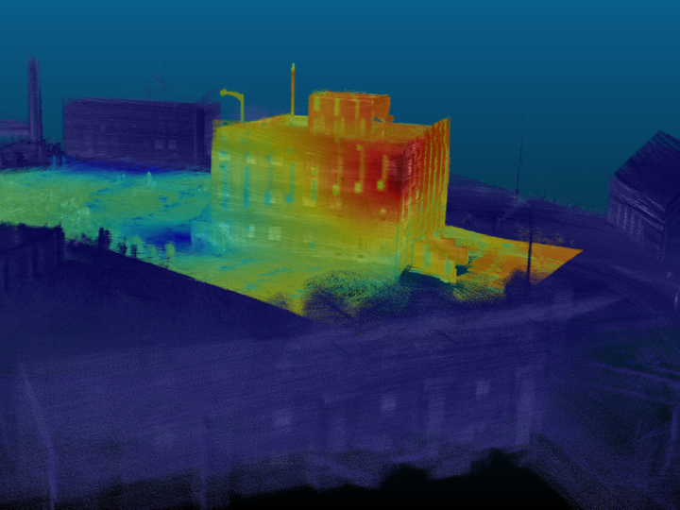
MOTIVATION: Gamma “Heat Map” produced by LAMP on drone
Unmanned Search Technology Demonstration at Camp Roberts
Unknowns:
Source
Source Activity
Source Location
Building Geometry
Building Materials
This image generated three questions?
Can we quantify the flux?
Can we differentiate between transmitted and scattered gammas?
Can we use this information to calculate Source Location?
Notes:
This image shows a comparative flux, but no actual rates or energies. This is helpful for localization, but more information on can help source identification, which can inform things such as exposure time for responders and recovery equipment required

Slide 4
METHODOLOGY: Model and Validate in a Controlled Scenario
Model:
Build model eliminating unknowns (Source, Activity, Location, Geometry, and Materials)
Run simulation to calculate instantaneous flux at detector.
Back Project instantaneous flux at detector to surface flux
Answers Question #1 - Quantification
Segregate simulation results (i.e. by energy or last location) and compare results to examine gamma transmission and scattering
Answers Question #2 - Differentiation
Apply Image Processing tools
Answers Question #3 - Localization
Validation:
Mathematically validate model using known flux/count-rate equations
Notes:
Back projection is a misnomer in this case.
Quantification is a misnomer

Slide 5
SEARCH SCENARIO: National Planning Scenario 11 – Radiological Attack
The Federal interagency community has developed 15 all-hazards National Planning Scenarios for use in national, Federal, State, and local homeland security preparedness activities. The Scenarios are planning tools and are representative of the range of potential terrorist attacks and natural disasters and the related impacts that face our nation. The objective was to develop a minimum number of credible scenarios in order to establish the range of response requirements to facilitate preparedness planning.
In Scenario 11, the Universal Adversary (UA) purchases a stolen Cobalt-60 (⁶⁰Co) Teletherapy source to make a Radiological Dispersal Device (RDD), or “dirty bomb.” The explosive and source are smuggled into the country. Detonator cord is stolen from a mining operation, and all other materials are obtained legally in the United States.
An activity about 444 TBq (12,000 Ci) is loaded initially in these machines. The ⁶⁰Co source decays at a rate of about 1% per month. Therefore, the mean activity encountered in these machines at any point of time range between 185–333 TBq (5000–9000 Ci).
*DHS National Planning Scenarios, March 2006
Notes:
Cobalt teletherapy machines have an edge over the linear accelerators because of less maintenance costs, less infrastructure requirements, low power demands, and simple quality assurance of the beam parameters.

Slide 6
SEARCH SCENARIO: Search Hierarchy
The Military normally conducts radiological search and recovery in four areas:
Beyond Line of Sight (BLOS) – satellite and high altitude reconnaissance systems
Far Area – fast moving airborne systems
Near Area – ground vehicle, helicopter, and Unmanned Aerial Systems (UAS)
Objective Area – Unmanned Ground Systems (UGS) and dismounted personnel
* Advances in UAS mounted detection will allow for the collection of information in the Near Area that once could only be collected in the Objective Area. These advances and additional ones in UGS will minimize personnel exposure in Objective Area.
Notes:
Beyond Line of Sight (BLOS) – Air Force
Far Area – Air Force
Near Area – just outside the effects range of hazard
Objective Area – within the effects range of hazard

Slide 7
MODEL DEVELOPEMENT: Tools
Medium-Energy Gamma-ray Astronomy library (MEGAlib)
Geometry for MEGAlib (Geomega) is MEGAlib's universal geometry and detector library. The geometry itself is described in a .geo file, which describes the volume tree, the materials, the detectors, the trigger criteria, etc.
The Cosmic simulator (Cosima) is MEGAlib's Geant4 based simulator. It utilizes the geometry and detector information from Geomega and source information file to perform the simulations.
The output sim file contains information on every gamma produced (6 million per sim) and every interaction from generation to contact/escaping volume.
* A. Zoglauer et al., Cosima - The cosmic simulator of MEGAlib, NSS Conference record, 2009
Notes:
Not trivial - Sim files are ~20 GB – have to write a script to strip applicable data [hit location, last interaction, energy, time] and write to NumPy array. ~90 MB

Slide 8
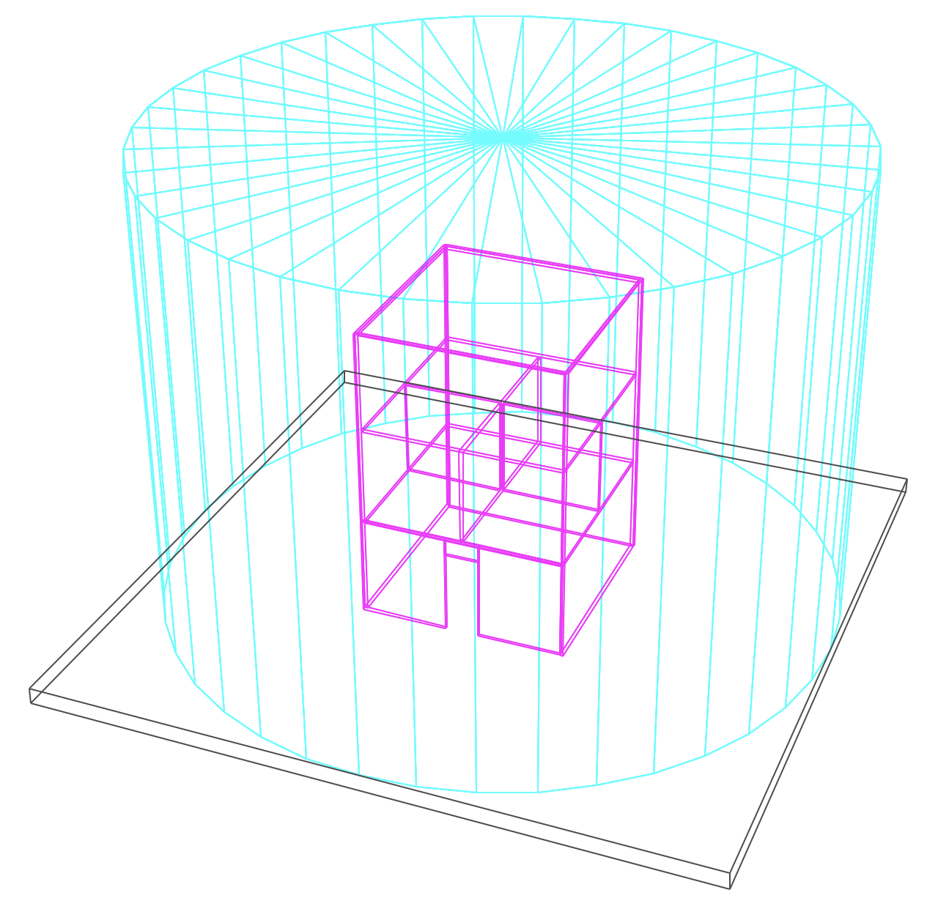
MODEL DEVELOPMENT: Concrete Building on Asphalt Surface
Pros:
Known Geometry
Known Materials
Easily Replicated in real world
Cons:
Simple Geometry does not fully reflect real world
Building is 9m tall with 6m length walls. First floor has open entry way. Second floor is divided into four rooms. “Detector” is ideal blackbody absorber (100% efficiency) in the shape of an encapsulated 14m tall cylinder with 10m radius. Source is modeled as point source.
Notes:
This approximates a UAS mounted detector system, with pre-plotted GPS coordinates, moving at a fixed radius around a building. Approach is detector agnostic, BB abo

Slide 9
MODEL DEVELOPEMENT: Materials
Concrete, Ordinary (NIST)
Density: 2.3 g/cm³
Weight Fractions:
H 0.022100
C 0.002484
O 0.574930
Na 0.015208
Mg 0.001266
Al 0.019953
Si 0.304627
K 0.010045
Ca 0.042951
Fe 0.006435
Asphalt Pavement
Density: 2.5784 g/cm³
Weight Fractions:
H 0.007781
C 0.076175
N 0.000363
O 0.459103
Na 0.011659
Mg 0.021757
Al 0.051009
Si 0.231474
S 0.002804
K 0.017058
Ca 0.084471
Ti 0.003403
V 0.000024
Mn 0.000362
Fe 0.031375
Ni 0.000002
Pb 0.001179

Slide 10
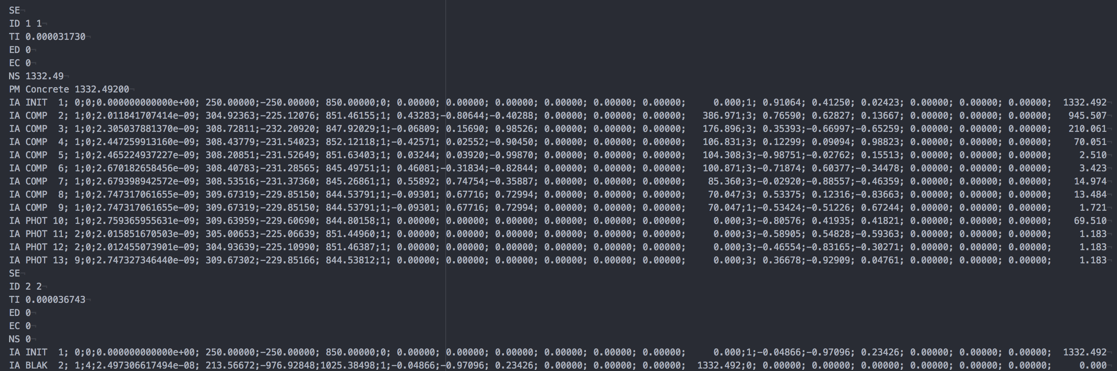
CODE IMPLEMENTATION: Sim Parsing
Parser code looks for hit in detector (BLAK). Saves location of detector hit and energy. Then looks for originating interaction and saves location of particle origin.
*Parser coverts 20GB sim file into a manageable 80MB file
Notes:
Compton scattering (COMP) is the scattering of a photon by a charged particle
Pair creation (PAIR) specifically to a photon creating an electron–positron pair,
Photo effect (PHOT) the emission of electrons or other free carriers when light hits a material.
Rayleigh scattering (RAYL) is the predominantly elastic scattering of light or other electromagnetic radiation by particles much smaller than the wavelength of the radiation.
Bremsstrahlung emission (BREM) electromagnetic radiation produced by the deceleration of a charged particle when deflected by another charged particle,
Inelastic scattering (INEL),
NS - Energy Deposited in Non-sensitive material
2: ID of this interaction
3: ID of interaction this particle originated from
4: Detector ID (see table of detector IDs)
5: Time since start of event in seconds
6: x position of interaction in cm
7: y position of interaction in cm
8: z position of interaction in cm
9: ID of original particle (see table of particle IDs)
10: New x direction of original particle
11: New y direction of original particle
12: New z direction of original particle
13: New x polarization of original particle
14: New y polarization of original particle
15: New z polarization of original particle
16: New kinetic energy of original particle in keV
17: ID of new particle (see table of particle IDs)
18: x direction of new particle
19: y direction of new particle
20: z direction of new particle
21: x polarization of new particle
22: y polarization of new particle
23: z polarization of new particle
24: Kinetic energy of new particle in keV

Slide 11
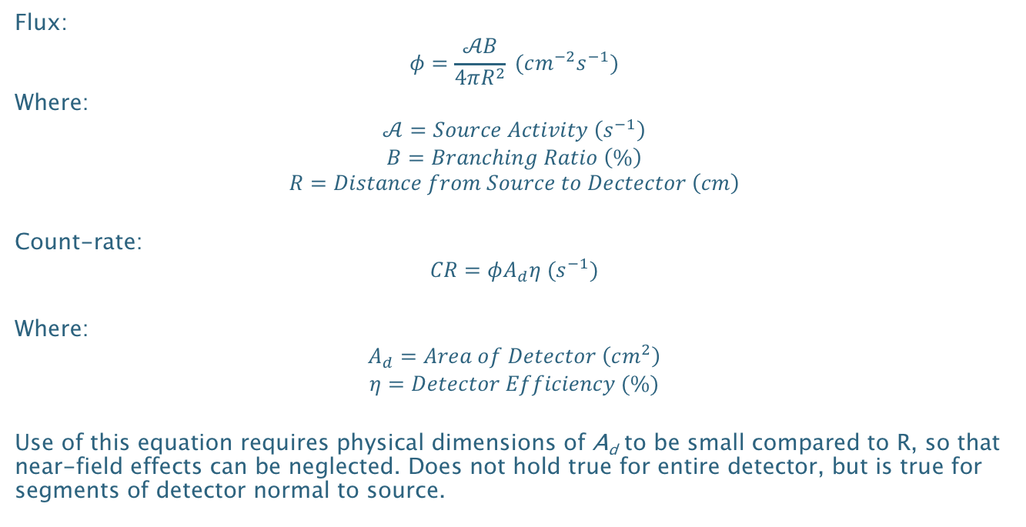
MODEL VALIDATION: Mathematical Flux and Count-rate Calculations
Flux:
$$φ=\frac{𝒜B}{4πR^{2}} (cm^{−2}s^{−1})$$
Where:
$$𝒜=Source Activity \left(s^{−1}\right)$$
$$B=Branching Ratio \left(\%\right)$$
$$R=Distance from Source to Dectector \left(cm\right)$$
Count-rate:
$$CR=φA_{d}η (s^{−1})$$
Where:
$$A_{d}=Area of Detector \left(cm^{2}\right)$$
$$η=Detector Efficiency (\%)$$
Use of this equation requires physical dimensions of A_{d} to be small compared to R, so that near-field effects can be neglected. Does not hold true for entire detector, but is true for segments of detector normal to source.
*Morse, Analytical Methods for Nonproliferation, pg. 24
Notes:
Flux equation is an approximation with particles traveling in 4𝜋 space and the area of the transit area as 4𝜋R². However, in reality, the area at R is a square on a spherical surface and the actual area is $A=R^{2}\int_{φ_{1}}^{φ_{2}}{\int_{θ_{1}}^{θ_{2}}{\sin{θ}dθ dφ}}$

Slide 12
MODEL VALIDATION: Mathematical Flux and Count-rate Calculations
Simulating ⁶⁰Co source producing 3 million gammas, 100% Branching Ratio for 1.332 MeV Gamma, 7.5 m distance, and 40cm * 3° (1570.8 cm²) Detector Area, and 100% efficiency.
Expected: 666.66 Expected Counts
Calculated: 668.21 Mean Counts, 24.87 St. Dev.
Notes:
Explain how model works
Run Sim
Parse by hits
Convert Cartesian to Cylindrical
Histogram Response

Slide 13
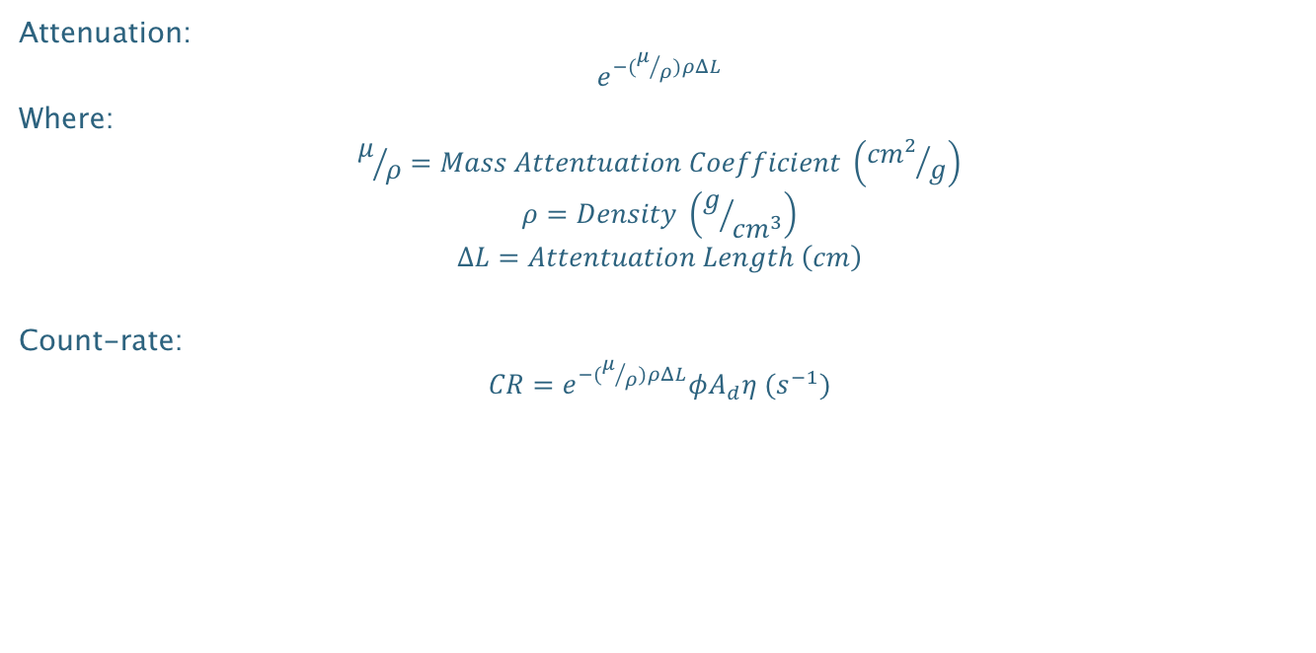
MODEL VALIDATION: Mathematical Flux and Count-rate Calculations with Attenuation
Attenuation:
$$e^{−(μ/ρ)ρΔL}$$
Where:
$$μ/ρ=Mass Attentuation Coefficient \left({{cm}^{2}}/g\right)$$
$$ρ=Density \left(g/{{cm}^{3}}\right)$$
$$∆L=Attentuation Length \left(cm\right)$$
Count-rate:
$$CR=e^{−(μ/ρ)ρΔL}φA_{d}η (s^{−1})$$
*Morse, Analytical Methods for Nonproliferation, pg. 24

Slide 14
MODEL VALIDATION: Mathematical Flux and Count-rate Calculations with Attenuation
0.062 Mass Attenuation Coefficient, 2.3 g/cm3 Density, and 10 cm Attenuation Length.
Expected: 60.998 Expected Counts
Calculated: 61.06 Mean Counts, 7.30 St. Dev.
*Mass Attenuation Coefficient for Concrete, Ordinary (NIST) from https://physics.nist.gov/PhysRefData/Xcom/html/xcom1.html

Slide 15
GEOMEGA MODEL: Segregating Simulation Data – Based off Energy and Last Location
Full Energy Deposition
Partial Energy Deposition – Concrete Scattered
Partial Energy Deposition – Asphalt Scattered
Notes:
Explain what don’t see – double attenuation

Slide 16
SIMULATION RESULTS: Parameters
Simulated source emission from nine locations within building. Each simulation generated 6 Million gammas.
*Center of building is on ground floor is (0,0,0)
Floor | Location | x [cm] | y [cm] | z [cm]
1 | Central | 50 | -50 | 50
1 | Mid | 150 | -150 | 150
1 | Wall | 250 | -250 | 250
2 | Central | 50 | -50 | 350
2 | Mid | 150 | -150 | 450
2 | Wall | 250 | -250 | 550
3 | Central | 50 | -50 | 650
3 | Mid | 150 | -150 | 750
3 | Wall | 250 | -250 | 850

Slide 17
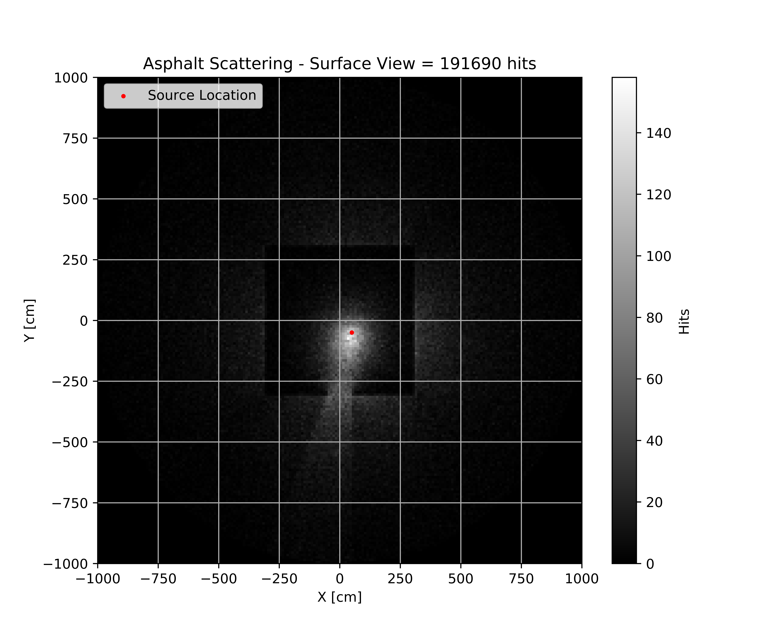
SIMULATON RESULTS:
⁶⁰Co Source
Located on 1st Floor (50,-50, 50)
6 Million 1.332 MeV Particles Generated
Notes:
For the right each pixel is 10 cm x 0.6º = 104.7 cm²
For the left each pixel is 10 cm x 10 cm = 100 cm²

Slide 18
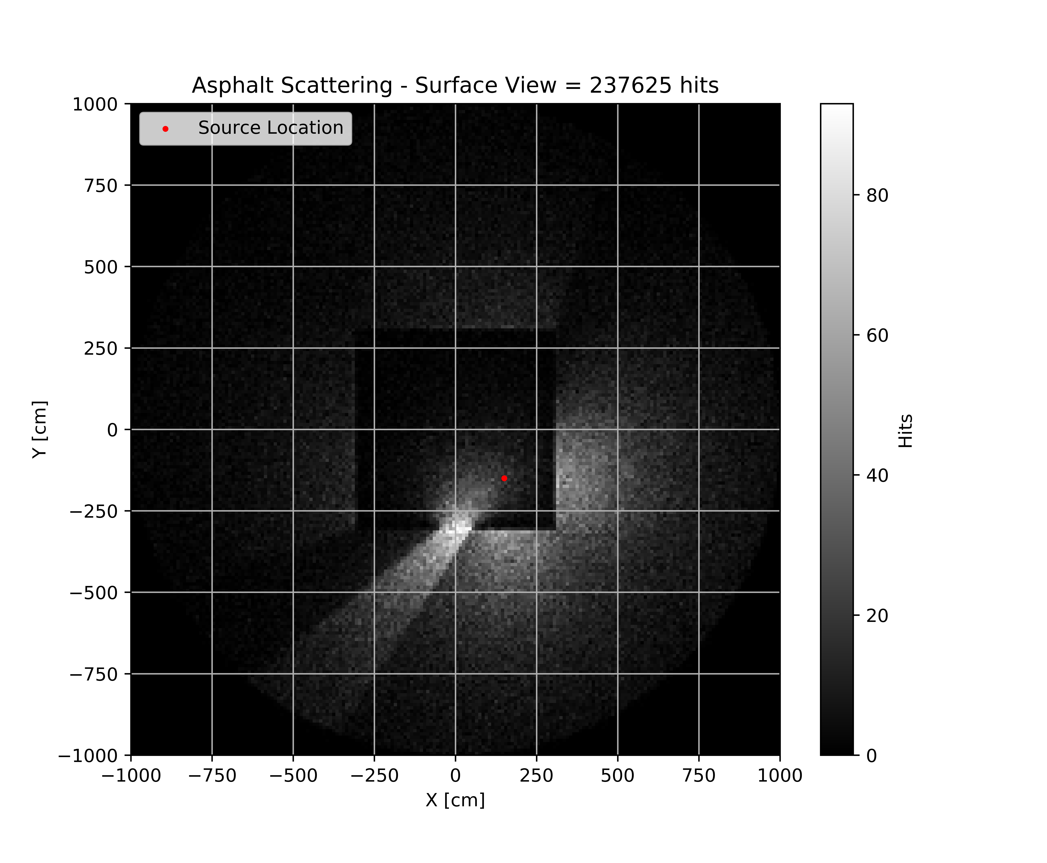
SIMULATON RESULTS:
⁶⁰Co Source
Located on 1st Floor (150,-150, 150)
6 Million 1.332 MeV Particles Generated
Notes:
For the right each pixel is 10 cm x 0.6º = 104.7 cm²
For the left each pixel is 10 cm x 10 cm = 100 cm²

Slide 19
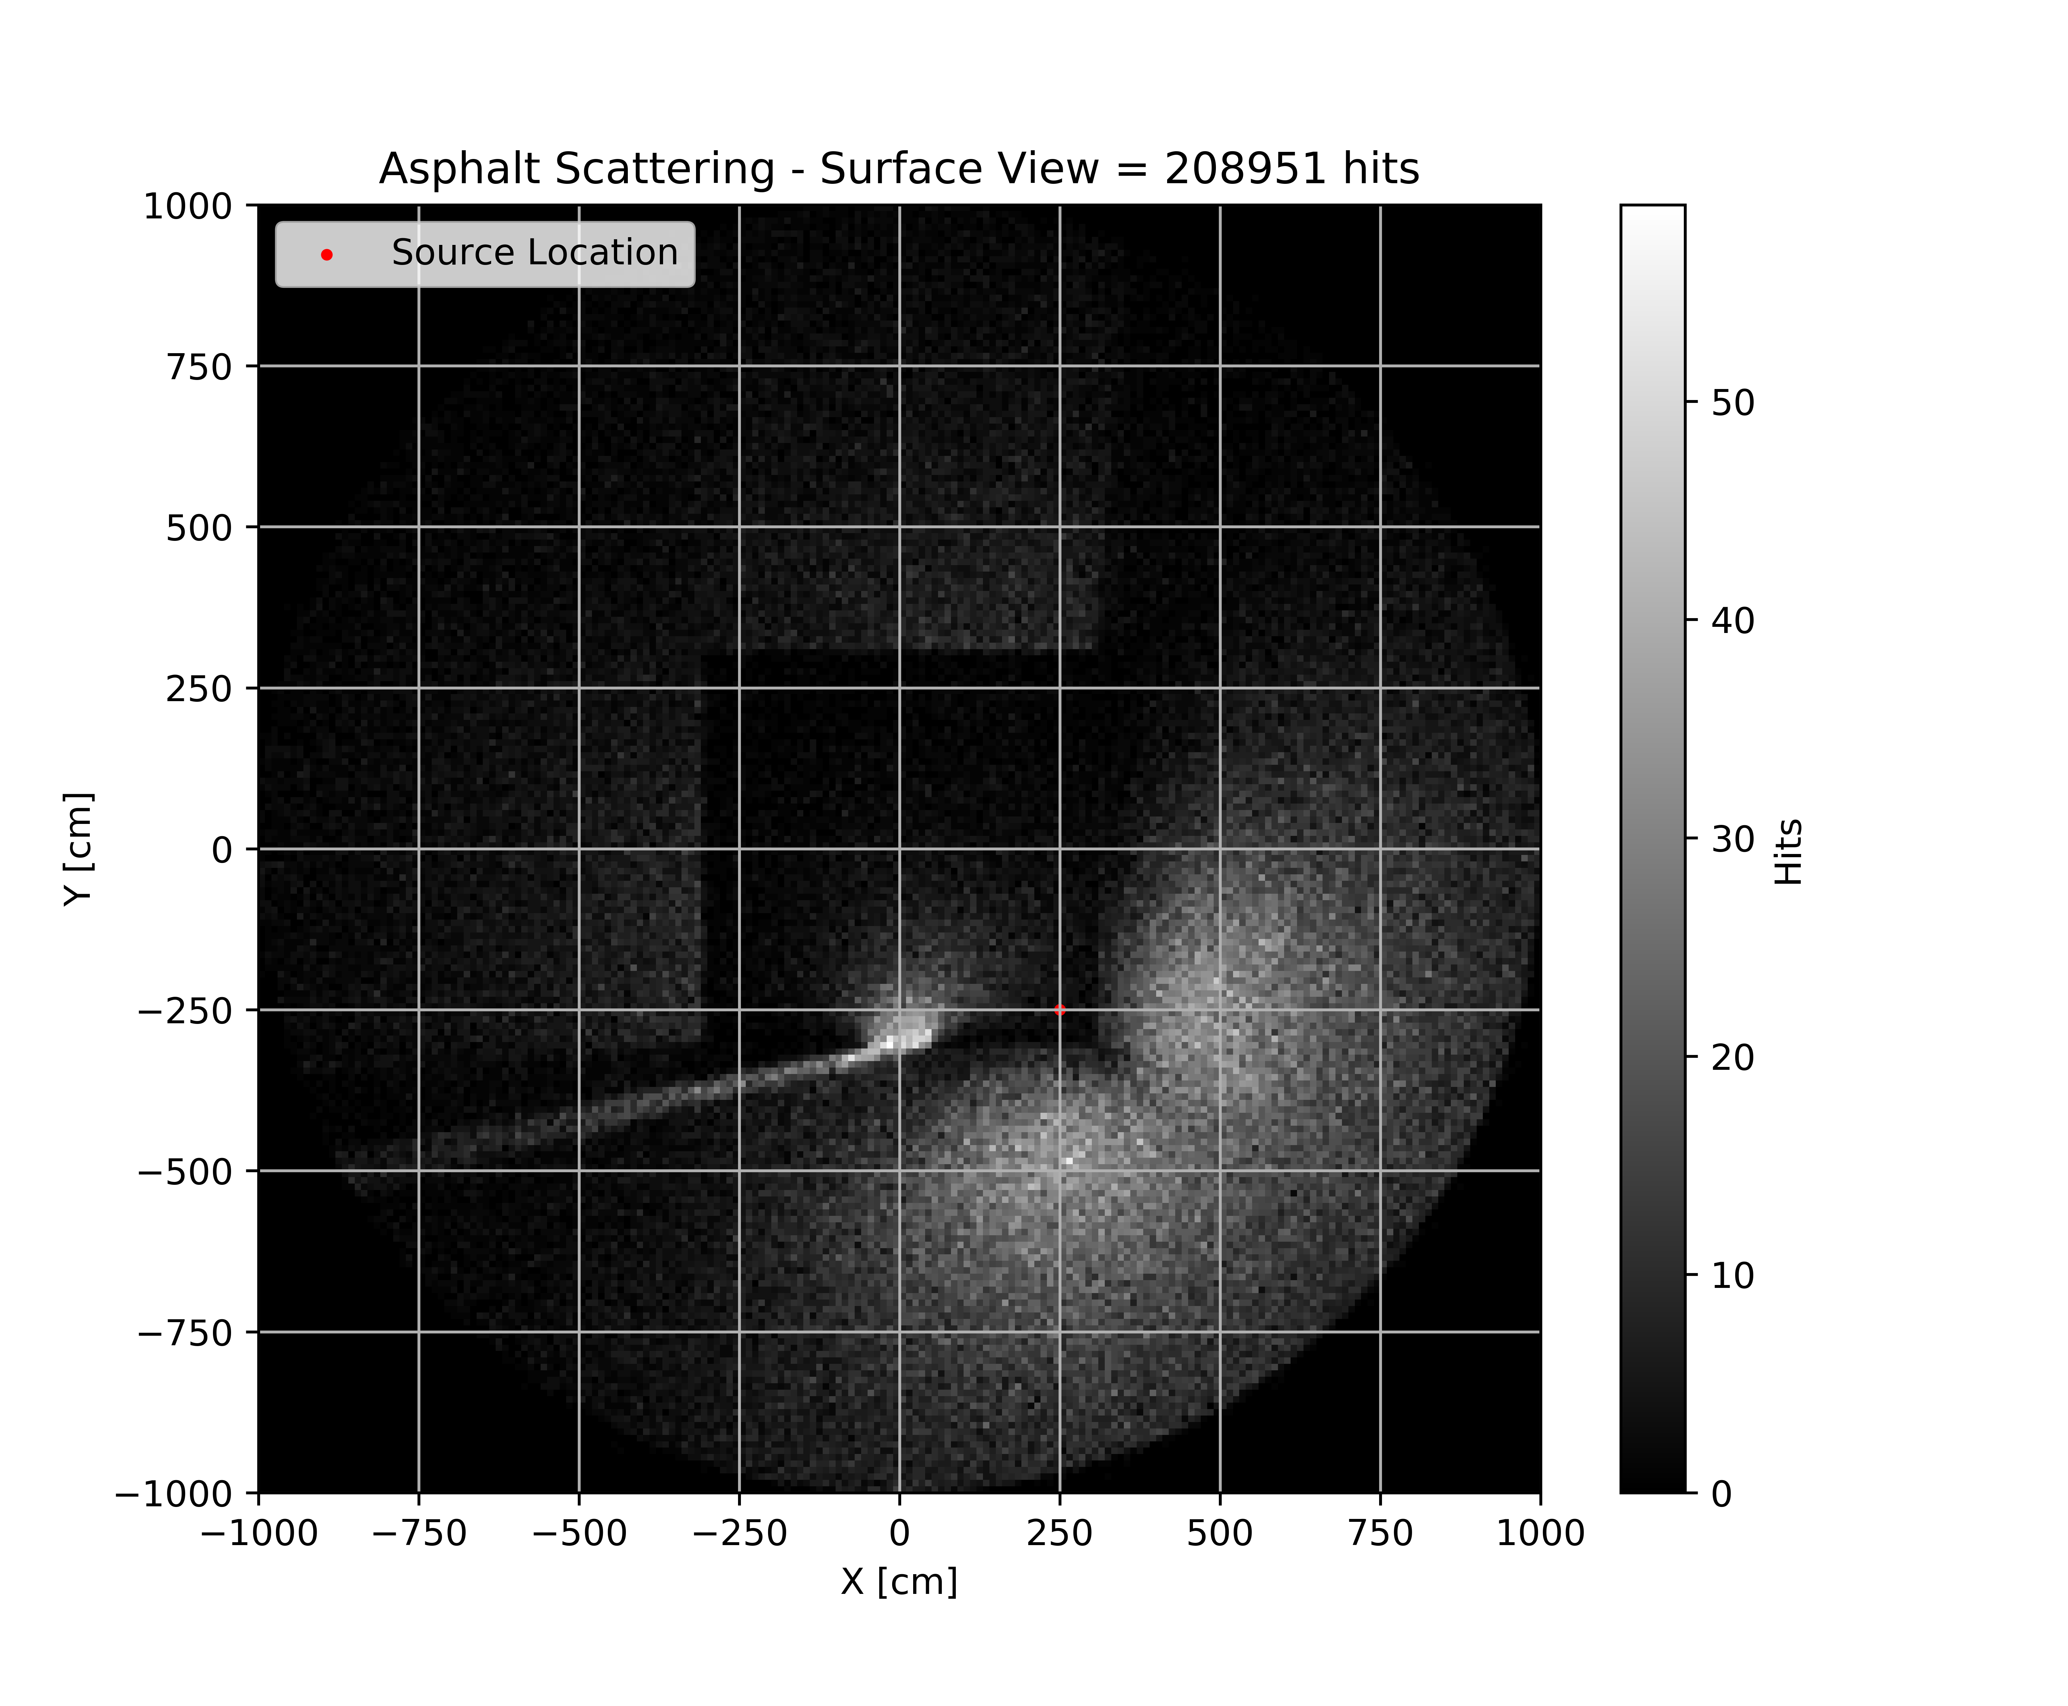
SIMULATON RESULTS:
⁶⁰Co Source
Located on 1st Floor (250,-250, 250)
6 Million 1.332 MeV Particles Generated
Notes:
For the right each pixel is 10 cm x 0.6º = 104.7 cm²
For the left each pixel is 10 cm x 10 cm = 100 cm²

Slide 20
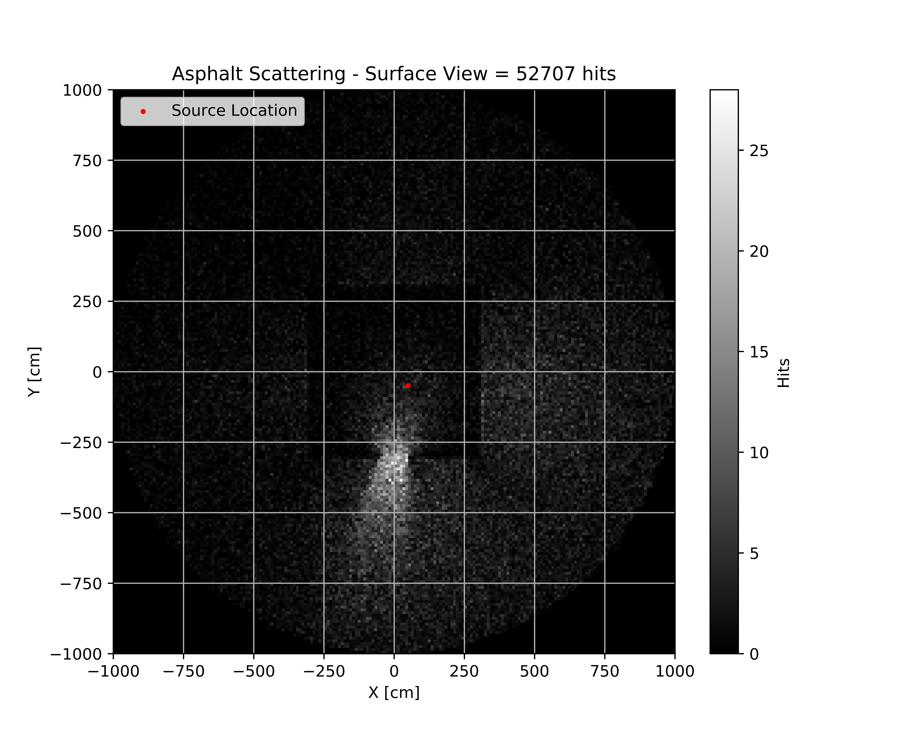
SIMULATON RESULTS:
⁶⁰Co Source
Located on 2nd Floor (50,-50, 350)
6 Million 1.332 MeV Particles Generated
Notes:
For the right each pixel is 10 cm x 0.6º = 104.7 cm²
For the left each pixel is 10 cm x 10 cm = 100 cm²

Slide 21
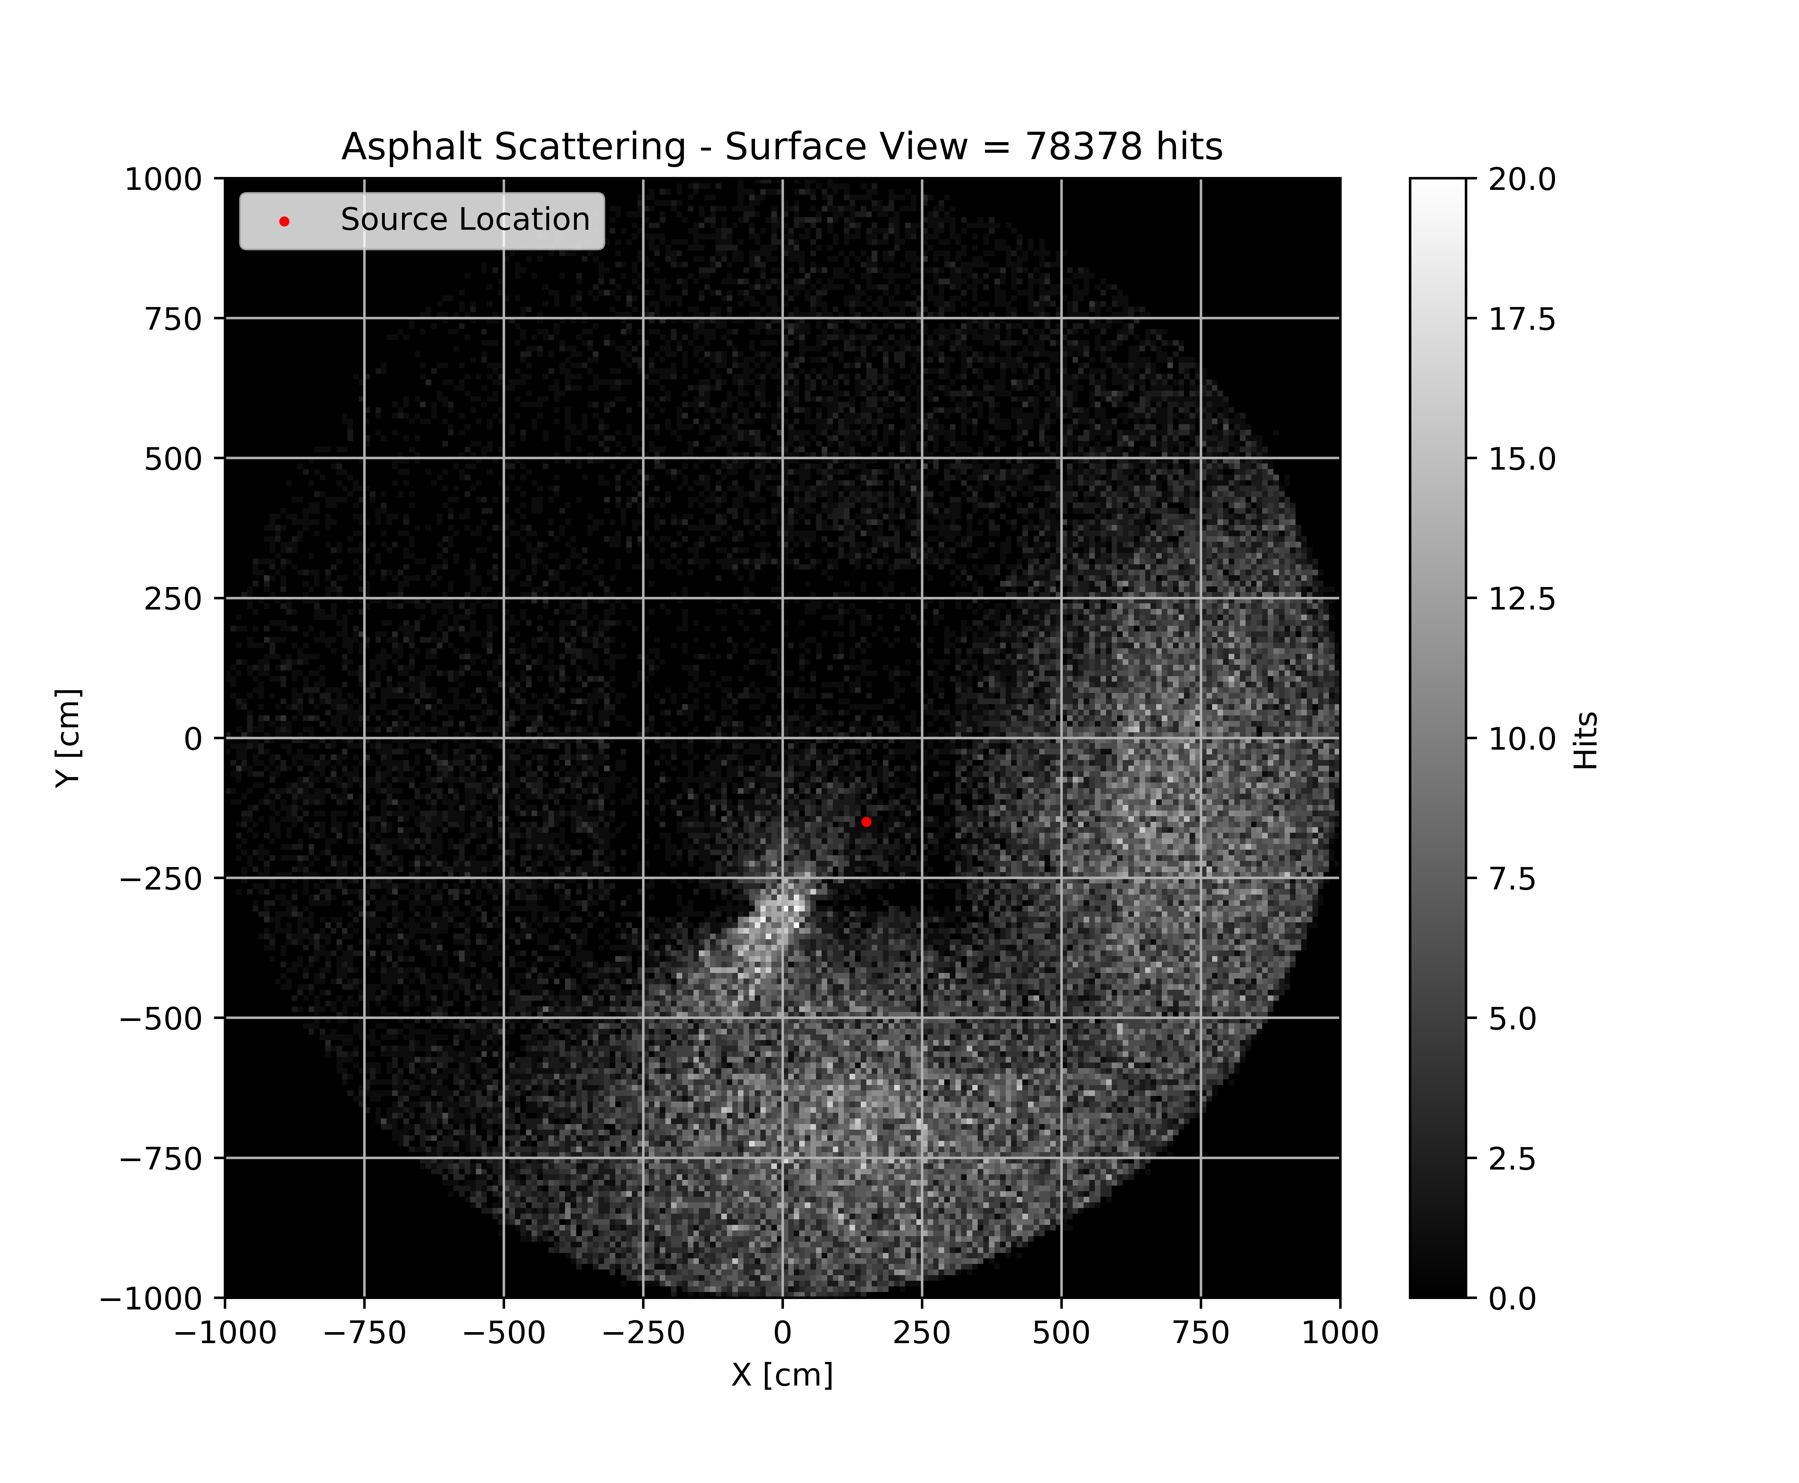
SIMULATON RESULTS:
⁶⁰Co Source
Located on 2nd Floor (150,-150, 450)
6 Million 1.332 MeV Particles Generated
Notes:
For the right each pixel is 10 cm x 0.6º = 104.7 cm²
For the left each pixel is 10 cm x 10 cm = 100 cm²

Slide 22
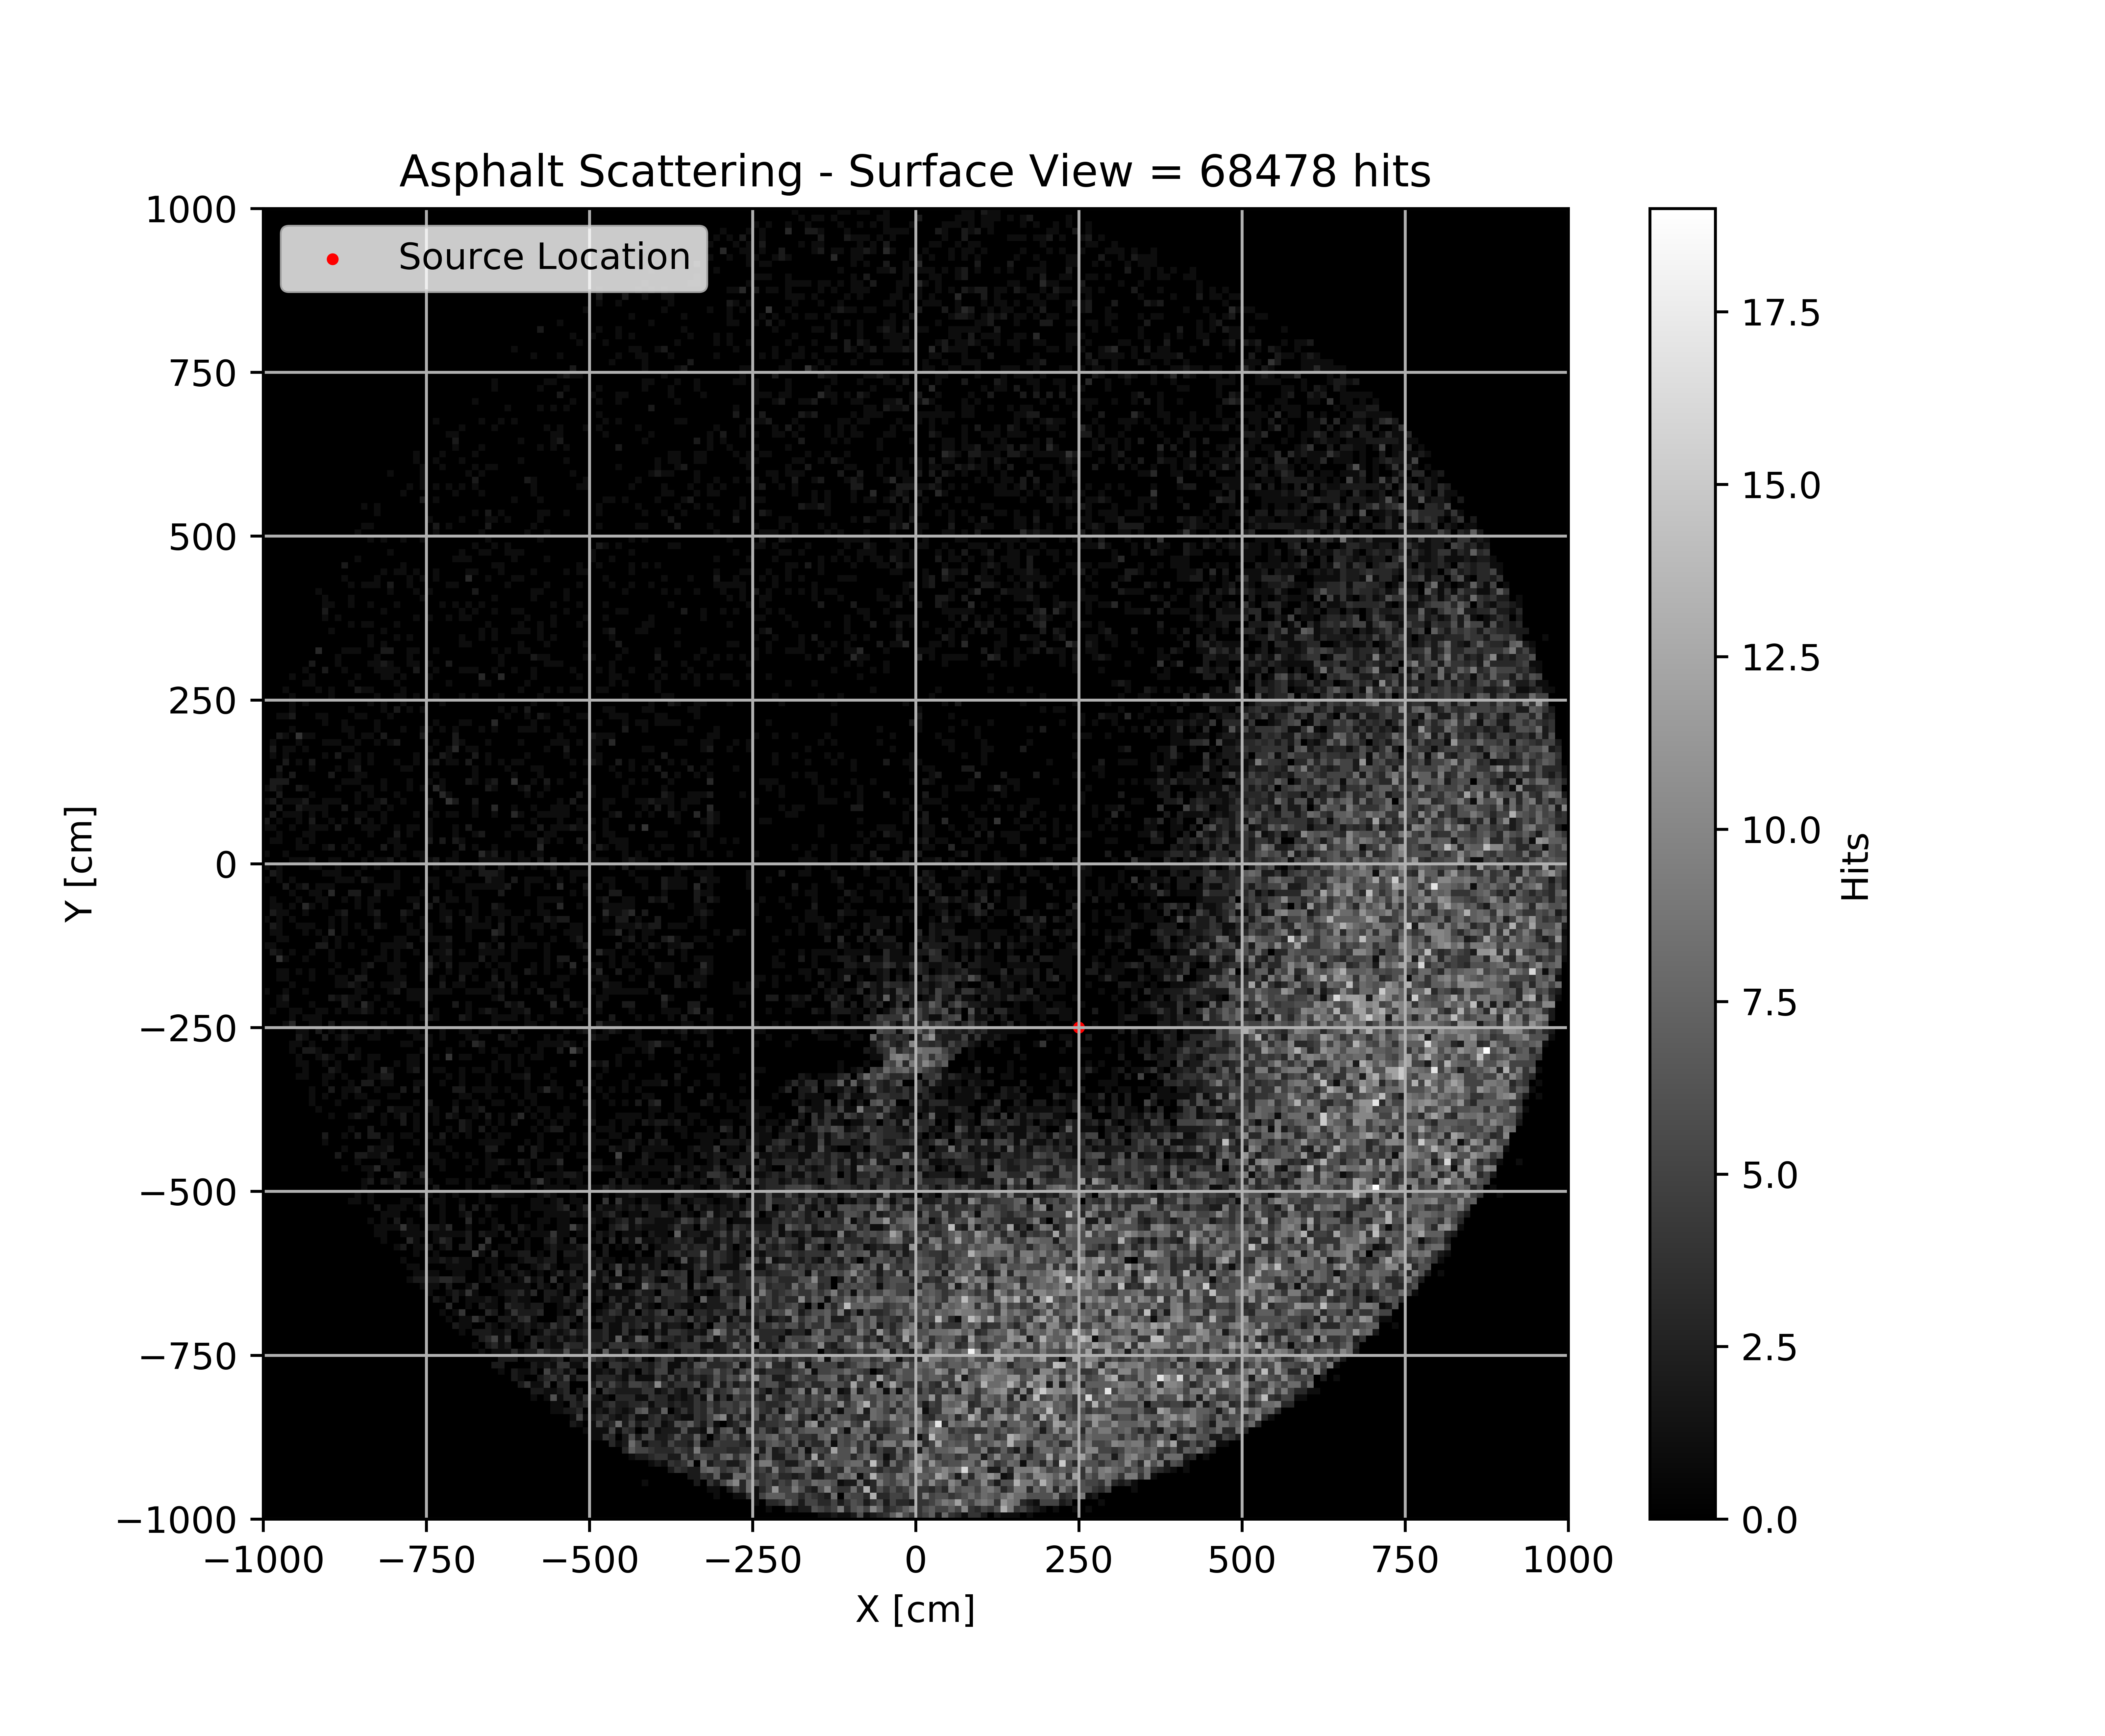
SIMULATON RESULTS:
⁶⁰Co Source
Located on 2nd Floor (250,-250, 550)
6 Million 1.332 MeV Particles Generated
Notes:
For the right each pixel is 10 cm x 0.6º = 104.7 cm²
For the left each pixel is 10 cm x 10 cm = 100 cm²

Slide 23
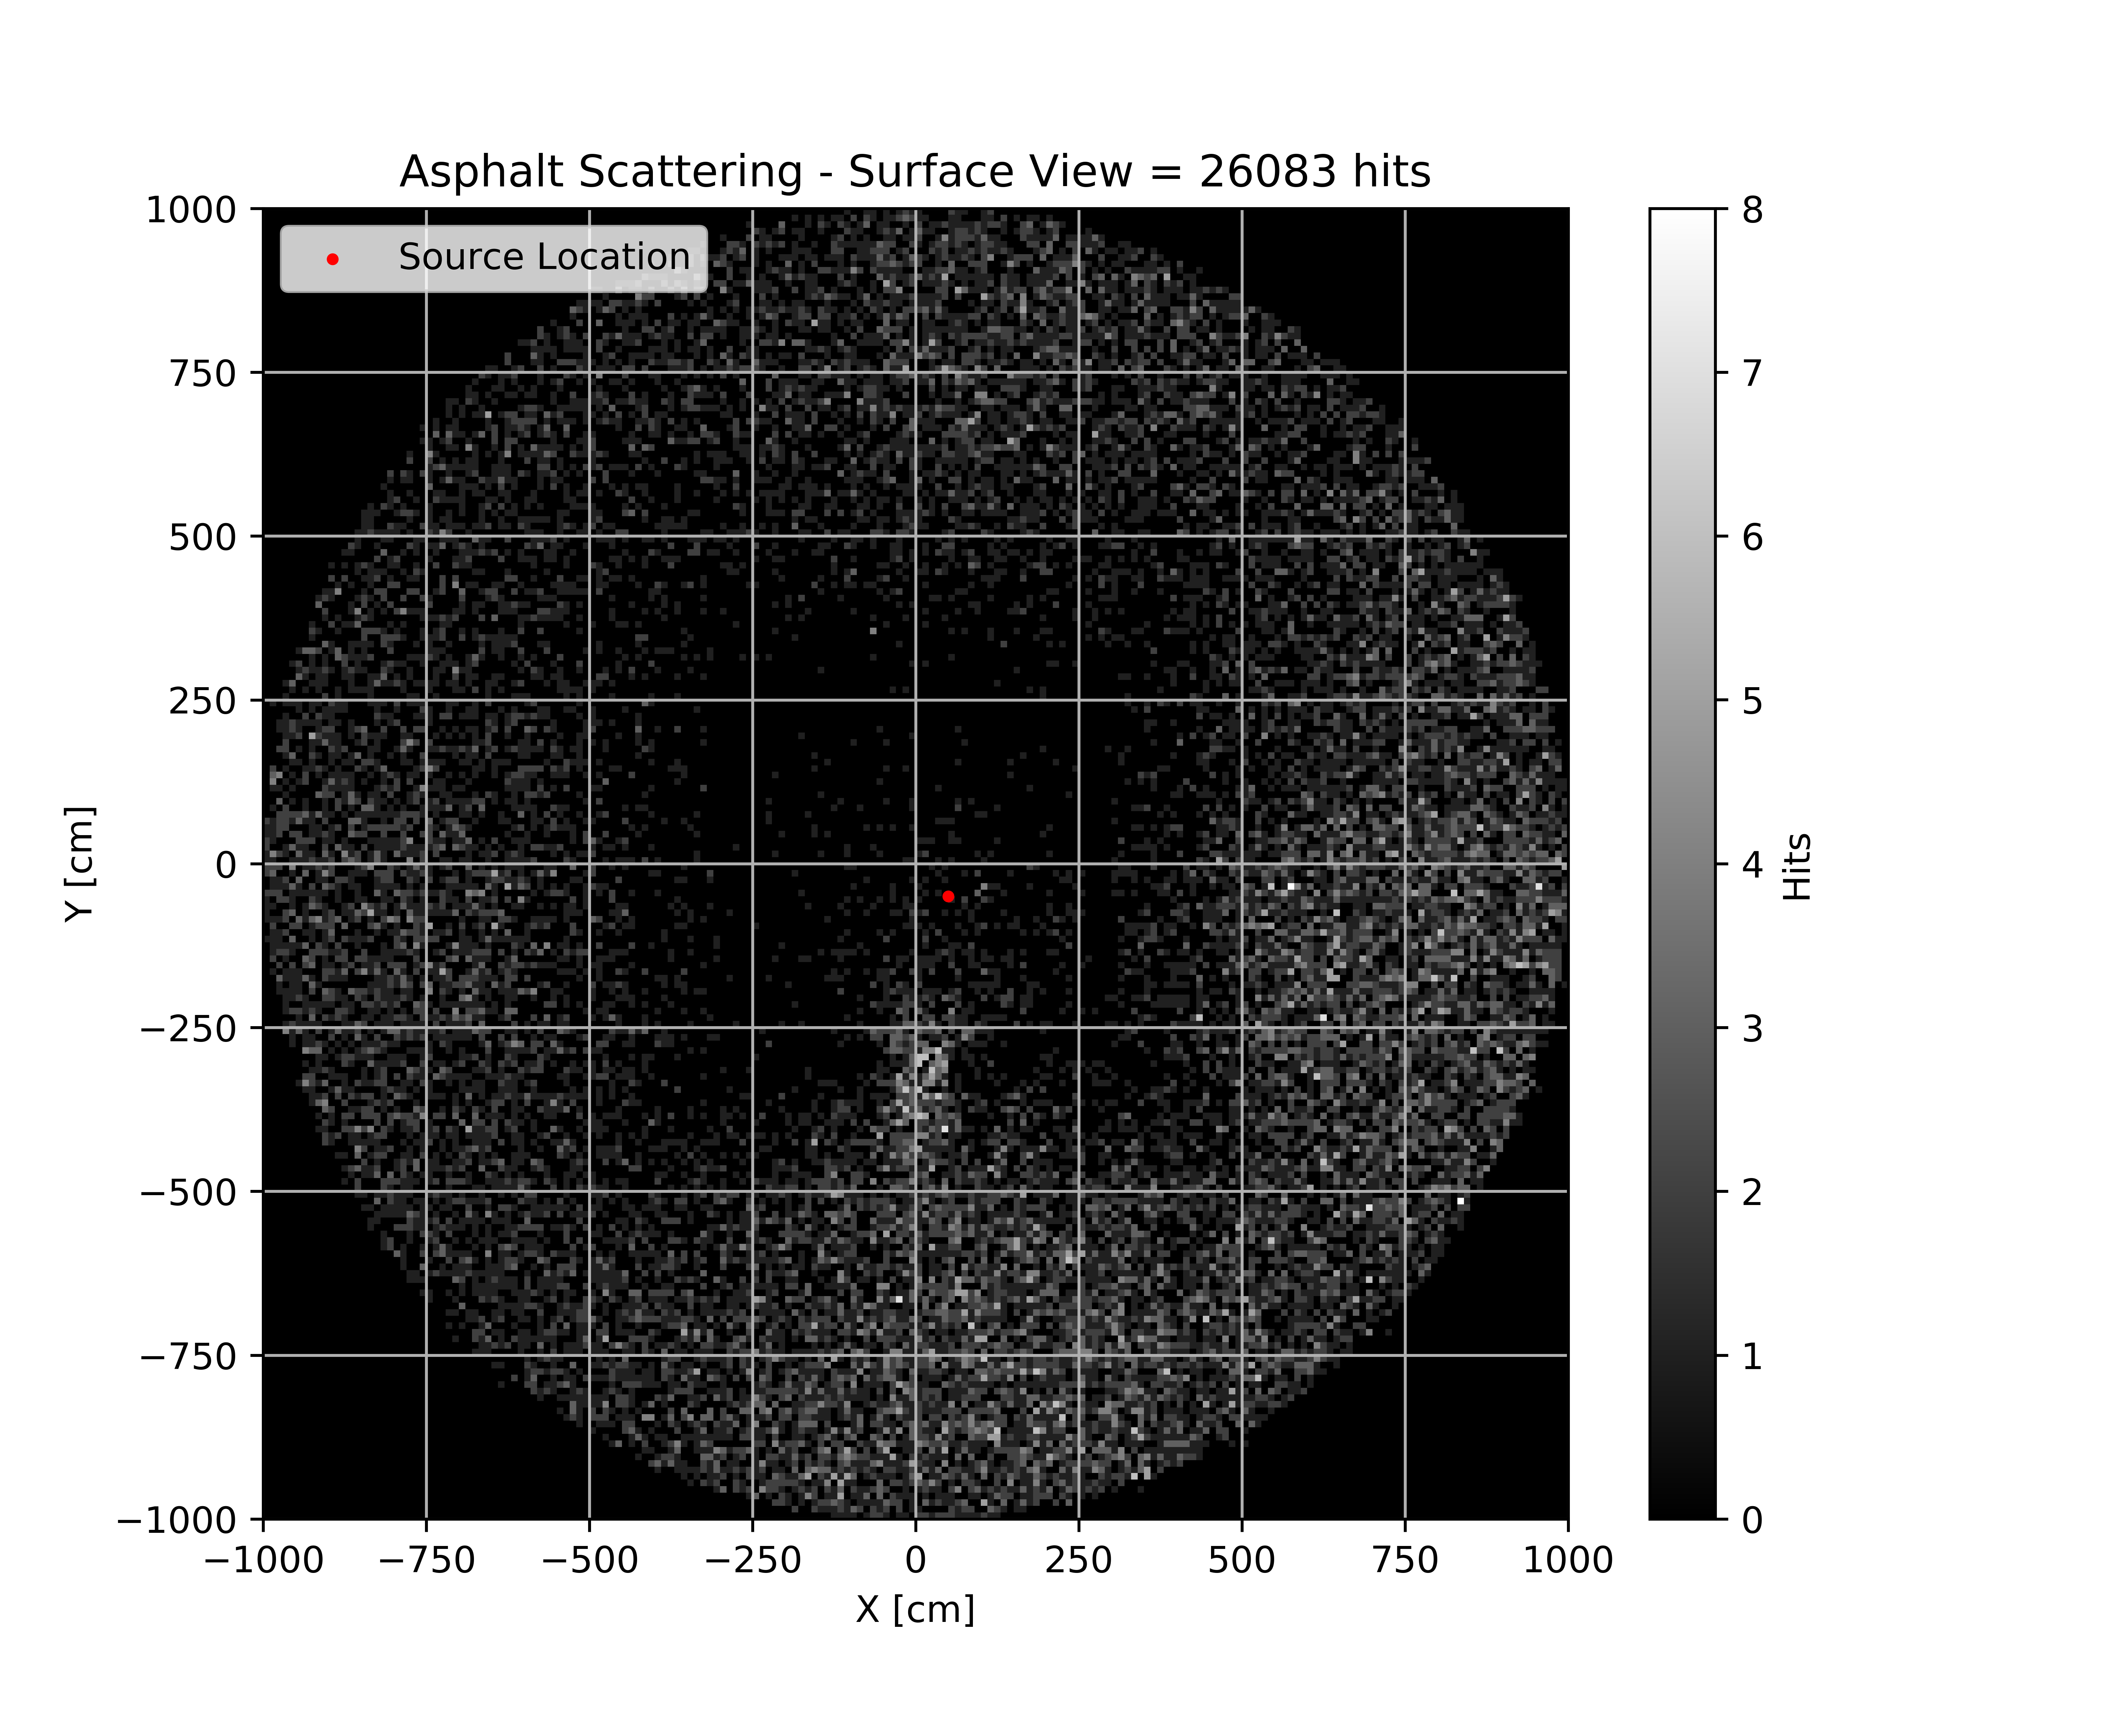
SIMULATON RESULTS:
⁶⁰Co Source
Located on 3rd Floor (50,-50, 650)
6 Million 1.332 MeV Particles Generated
Notes:
For the right each pixel is 10 cm x 0.6º = 104.7 cm²
For the left each pixel is 10 cm x 10 cm = 100 cm²

Slide 24

SIMULATON RESULTS:
⁶⁰Co Source
Located on 3rd Floor (150,-150, 750)
6 Million 1.332 MeV Particles Generated
Notes:
For the right each pixel is 10 cm x 0.6º = 104.7 cm²
For the left each pixel is 10 cm x 10 cm = 100 cm²

Slide 25
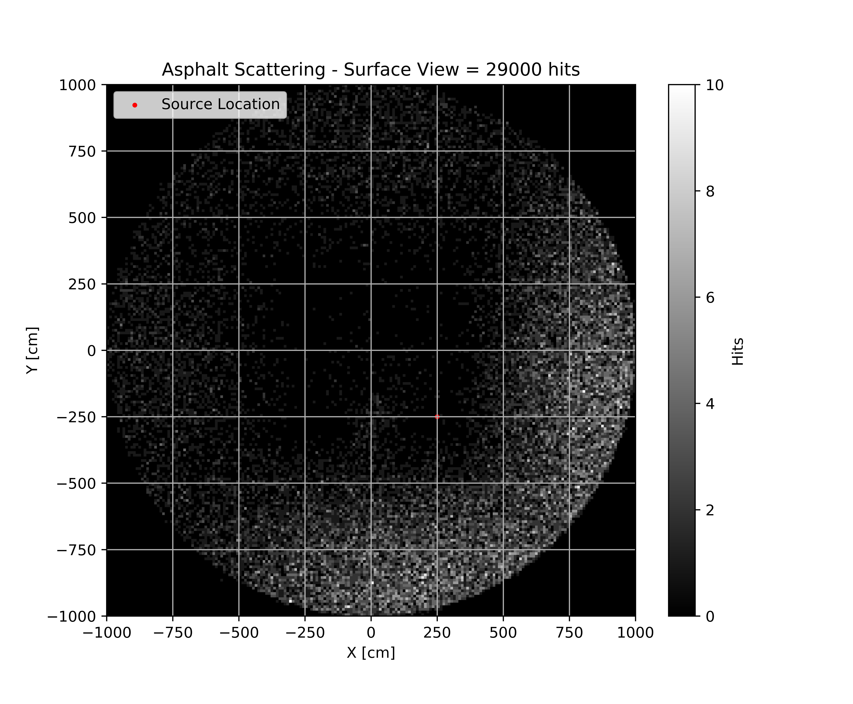
SIMULATON RESULTS:
⁶⁰Co Source
Located on 3rd Floor (250,-250, 850)
6 Million 1.332 MeV Particles Generated
Notes:
For the right each pixel is 10 cm x 0.6º = 104.7 cm²
For the left each pixel is 10 cm x 10 cm = 100 cm²

Slide 26
SIMULATON RESULTS: Back Projected Flux at Building Surface
Notes:
⁶⁰Co Source
Located on 1st Floor (50,-50, 50)
6 Million 1.332 MeV Particles Generated

Slide 27
SIMULATON RESULTS: Back Projected Flux at Building Surface
Notes:
⁶⁰Co Source
Located on 2nd Floor (150,-150, 450)
6 Million 1.332 MeV Particles Generated

Slide 28
SIMULATON RESULTS: Back Projected Flux at Building Surface
Notes:
⁶⁰Co Source
Located on 3rd Floor (250,-250, 850)
6 Million 1.332 MeV Particles Generated

Slide 29
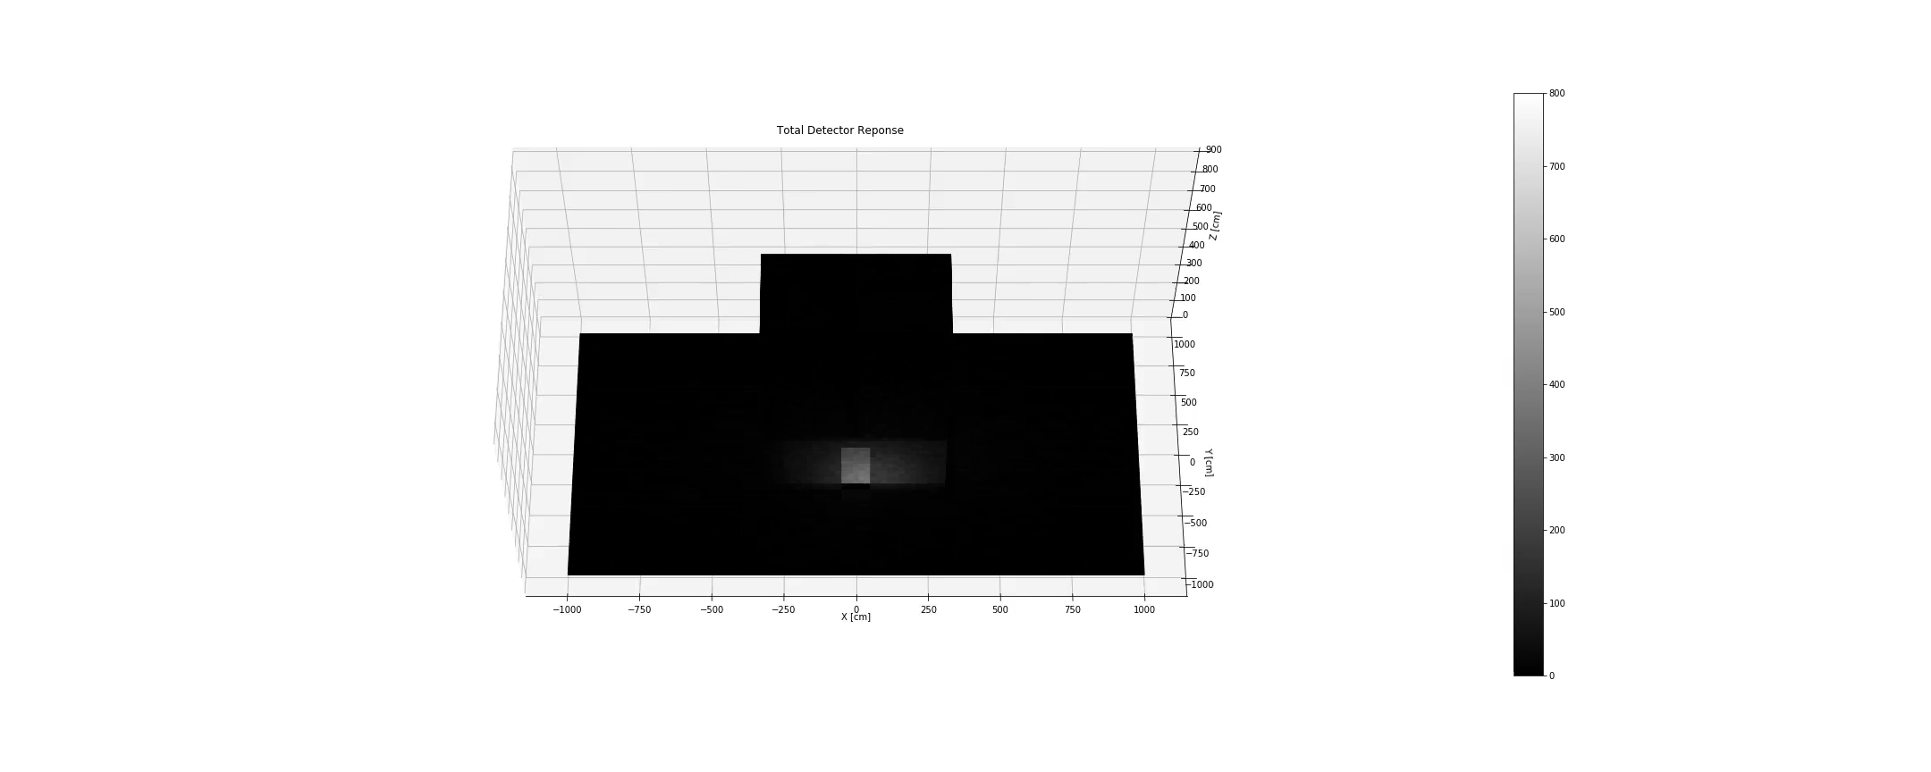
SIMULATON RESULTS: 3D Flux – Total

Slide 30
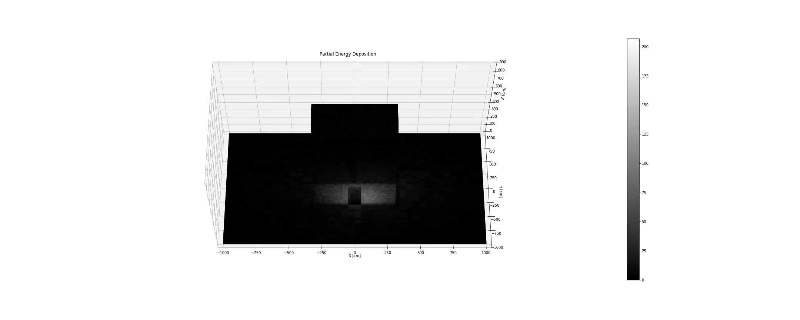
SIMULATON RESULTS: 3D Flux – Partial

Slide 31
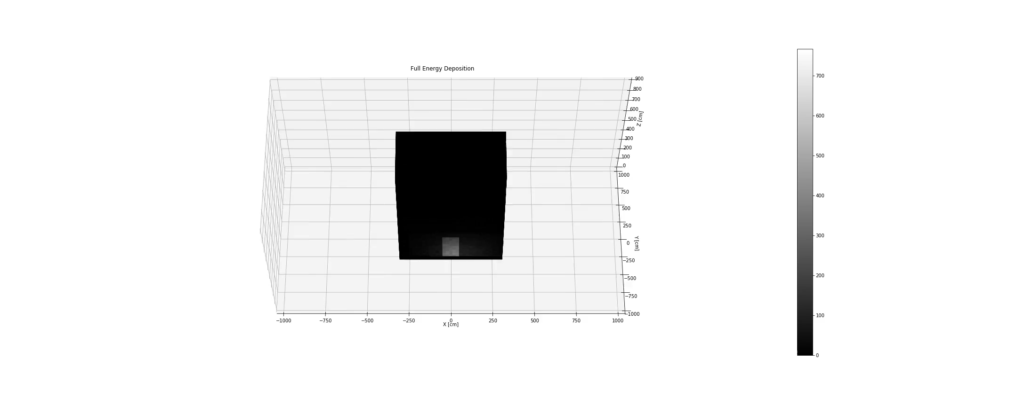
SIMULATON RESULTS: 3D Flux – 1332 keV

Slide 32
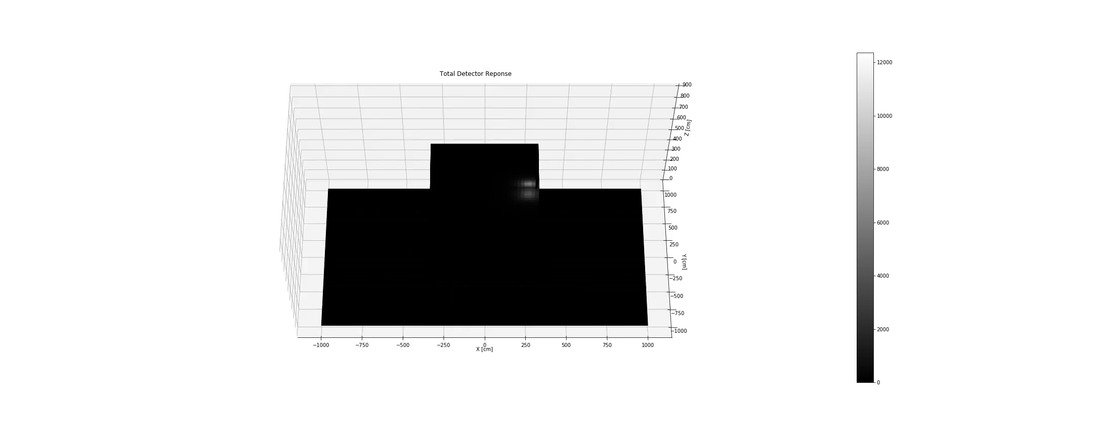
SIMULATON RESULTS: 3D Flux – Total

Slide 33

SIMULATON RESULTS: 3D Flux – Partial

Slide 34
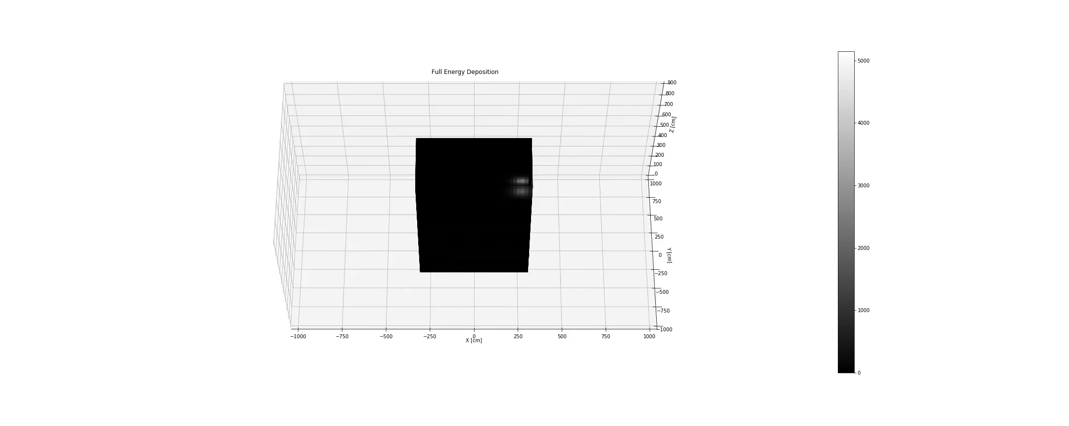
SIMULATON RESULTS: 3D Flux – 1332 keV

Slide 35
LOCALIZATION: Canny Edge Finder and Random Sample Consensus (RANSAC) fit
Canny Edge Finder:
Apply Gaussian Filter to remove noise from image
Compute the intensity of the gradients
Thin edges to 1-pixel be removing non-maximum pixels of the gradient
RANSAC fit:
Select a random subset of the original data. Call this subset the hypothetical inliers.
A model is fitted to the set of hypothetical inliers.
All other data are then tested against the fitted model. Those points that fit the estimated model well are considered as part of the consensus set.
Re-estimate model using all members of the consensus set.
Localization:
Calculate line segments connecting estimated source location for East/West and North/South planes
Estimated source location is line intersection or midpoint of shortest distance between lines
*John Canny, A Computational Approach to Edge Detection
*Martin Fischler & Robert Bolles, Random Sample Consensus: A Paradigm for Model Fitting with Applications to Image Analysis and Automated Cartography

Slide 36
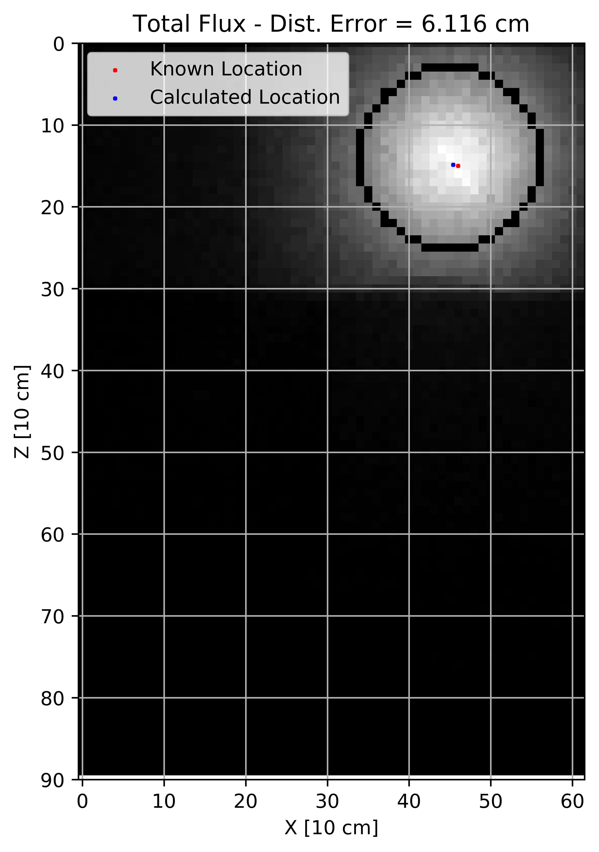
LOCALIZATION: Canny Edge Finder and RANSAC fit – Total Detector Response
⁶⁰Co Source Located on 3rd Floor of BLDG
Viewing from South
Notes:
Explain features

Slide 37
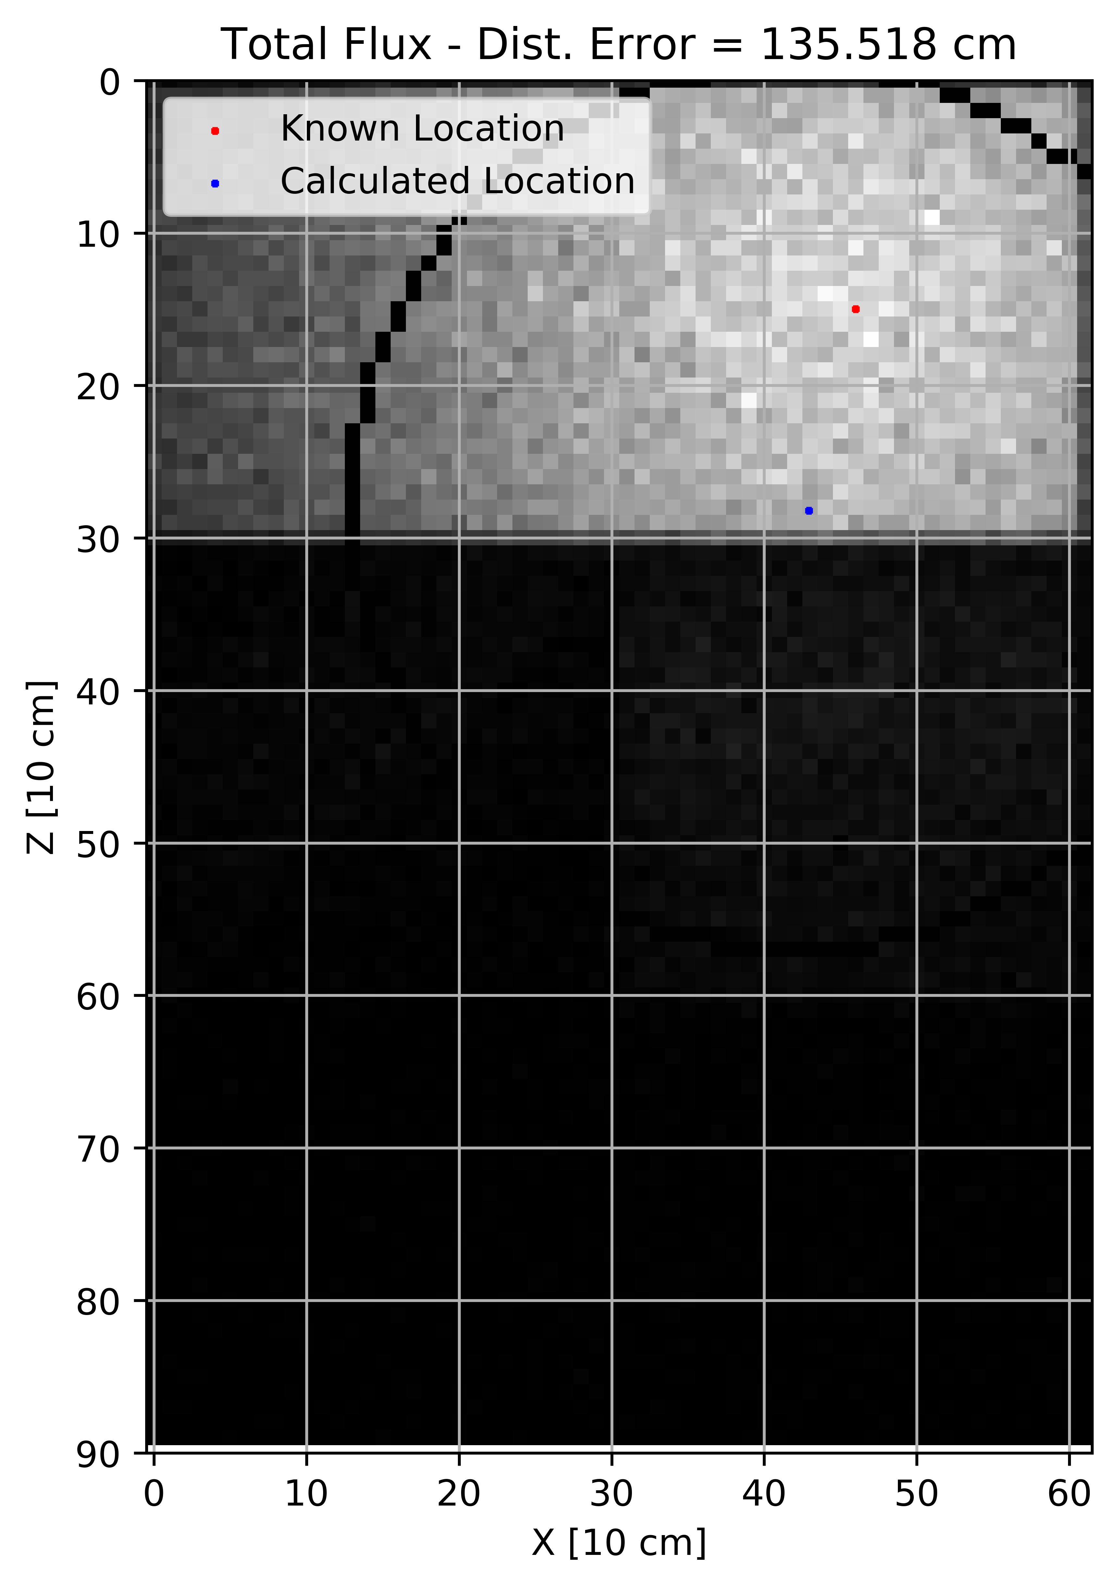
LOCALIZATION: Canny Edge Finder and RANSAC fit – Total Detector Response
⁶⁰Co Source Located on 3rd Floor of BLDG
Viewing from North
Notes:
Explain features

Slide 38
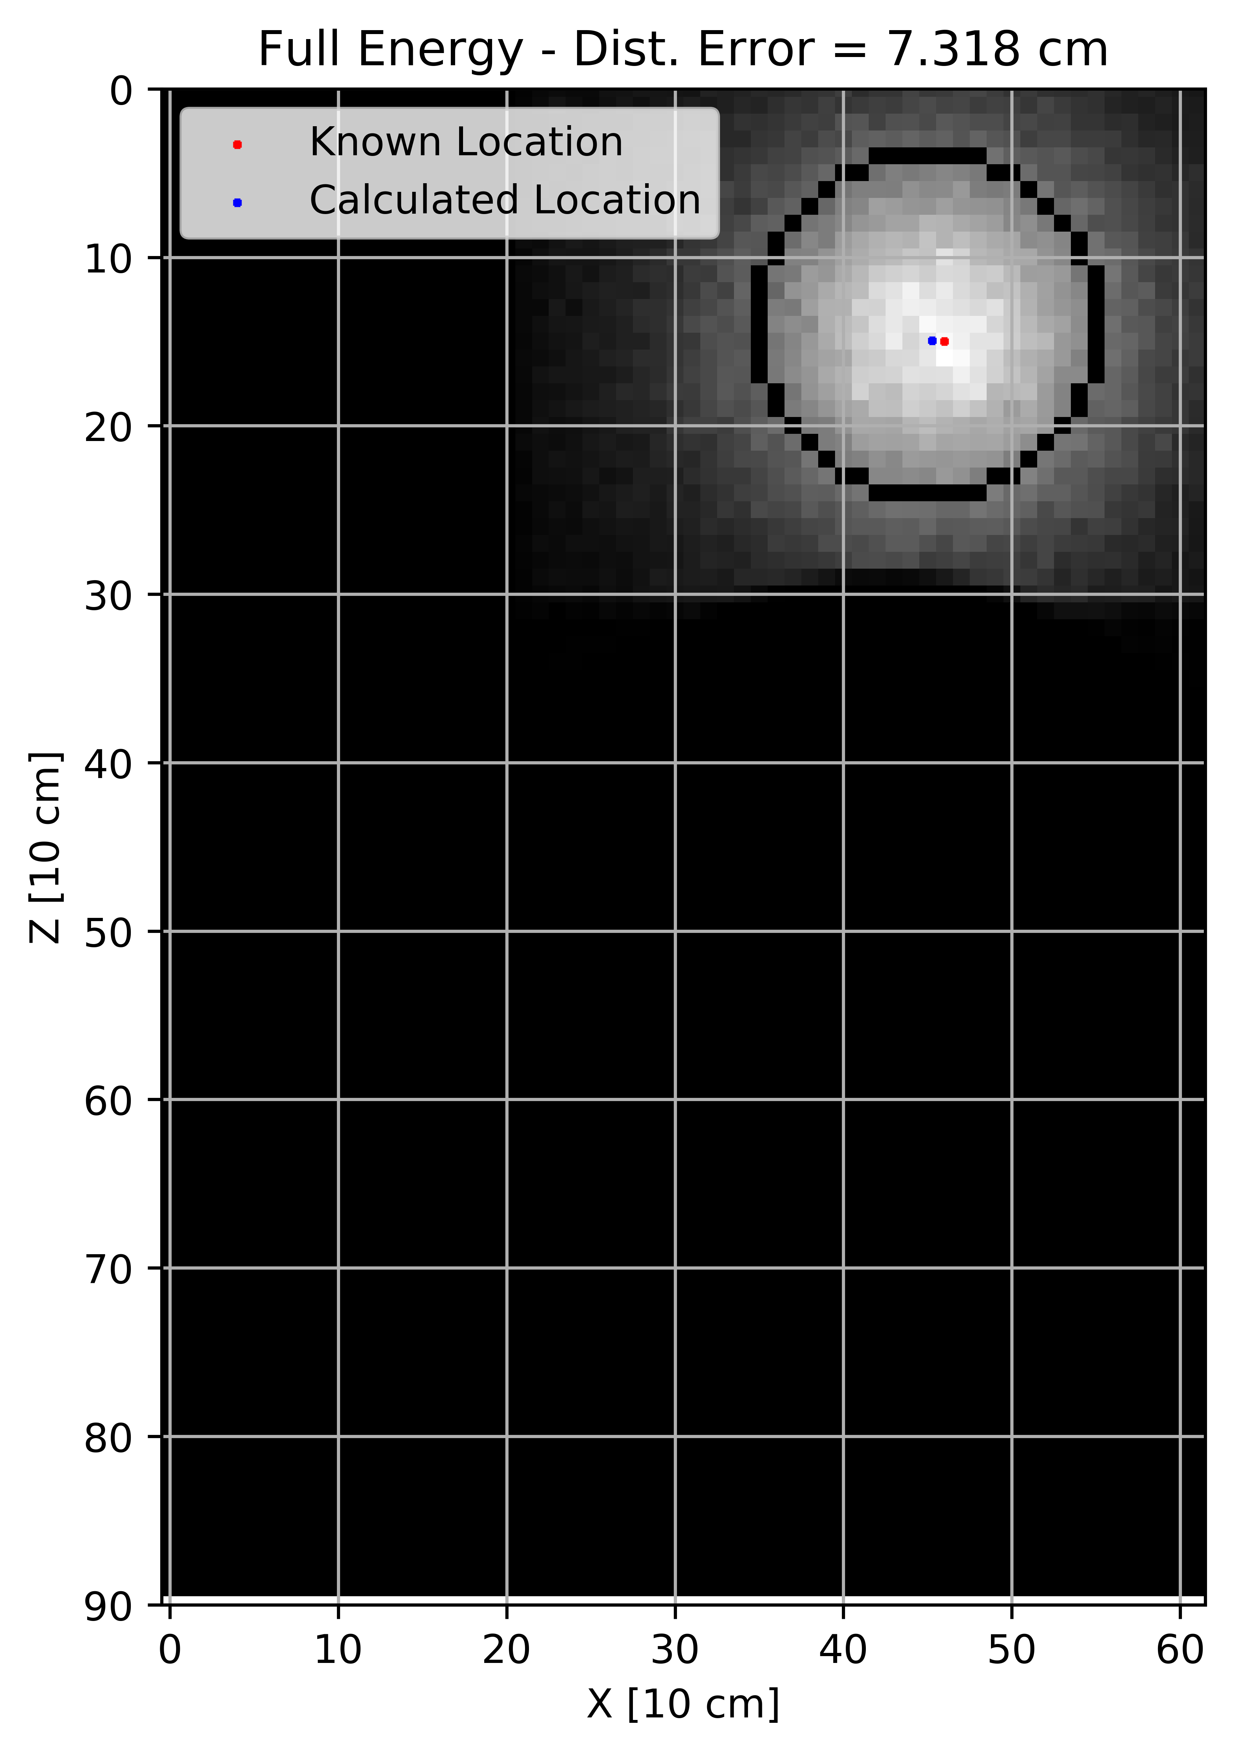
LOCALIZATION: Canny Edge Finder and RANSAC fit – Full Energy
⁶⁰Co Source Located on 3rd Floor of BLDG
Viewing from South
Notes:
Explain features

Slide 39
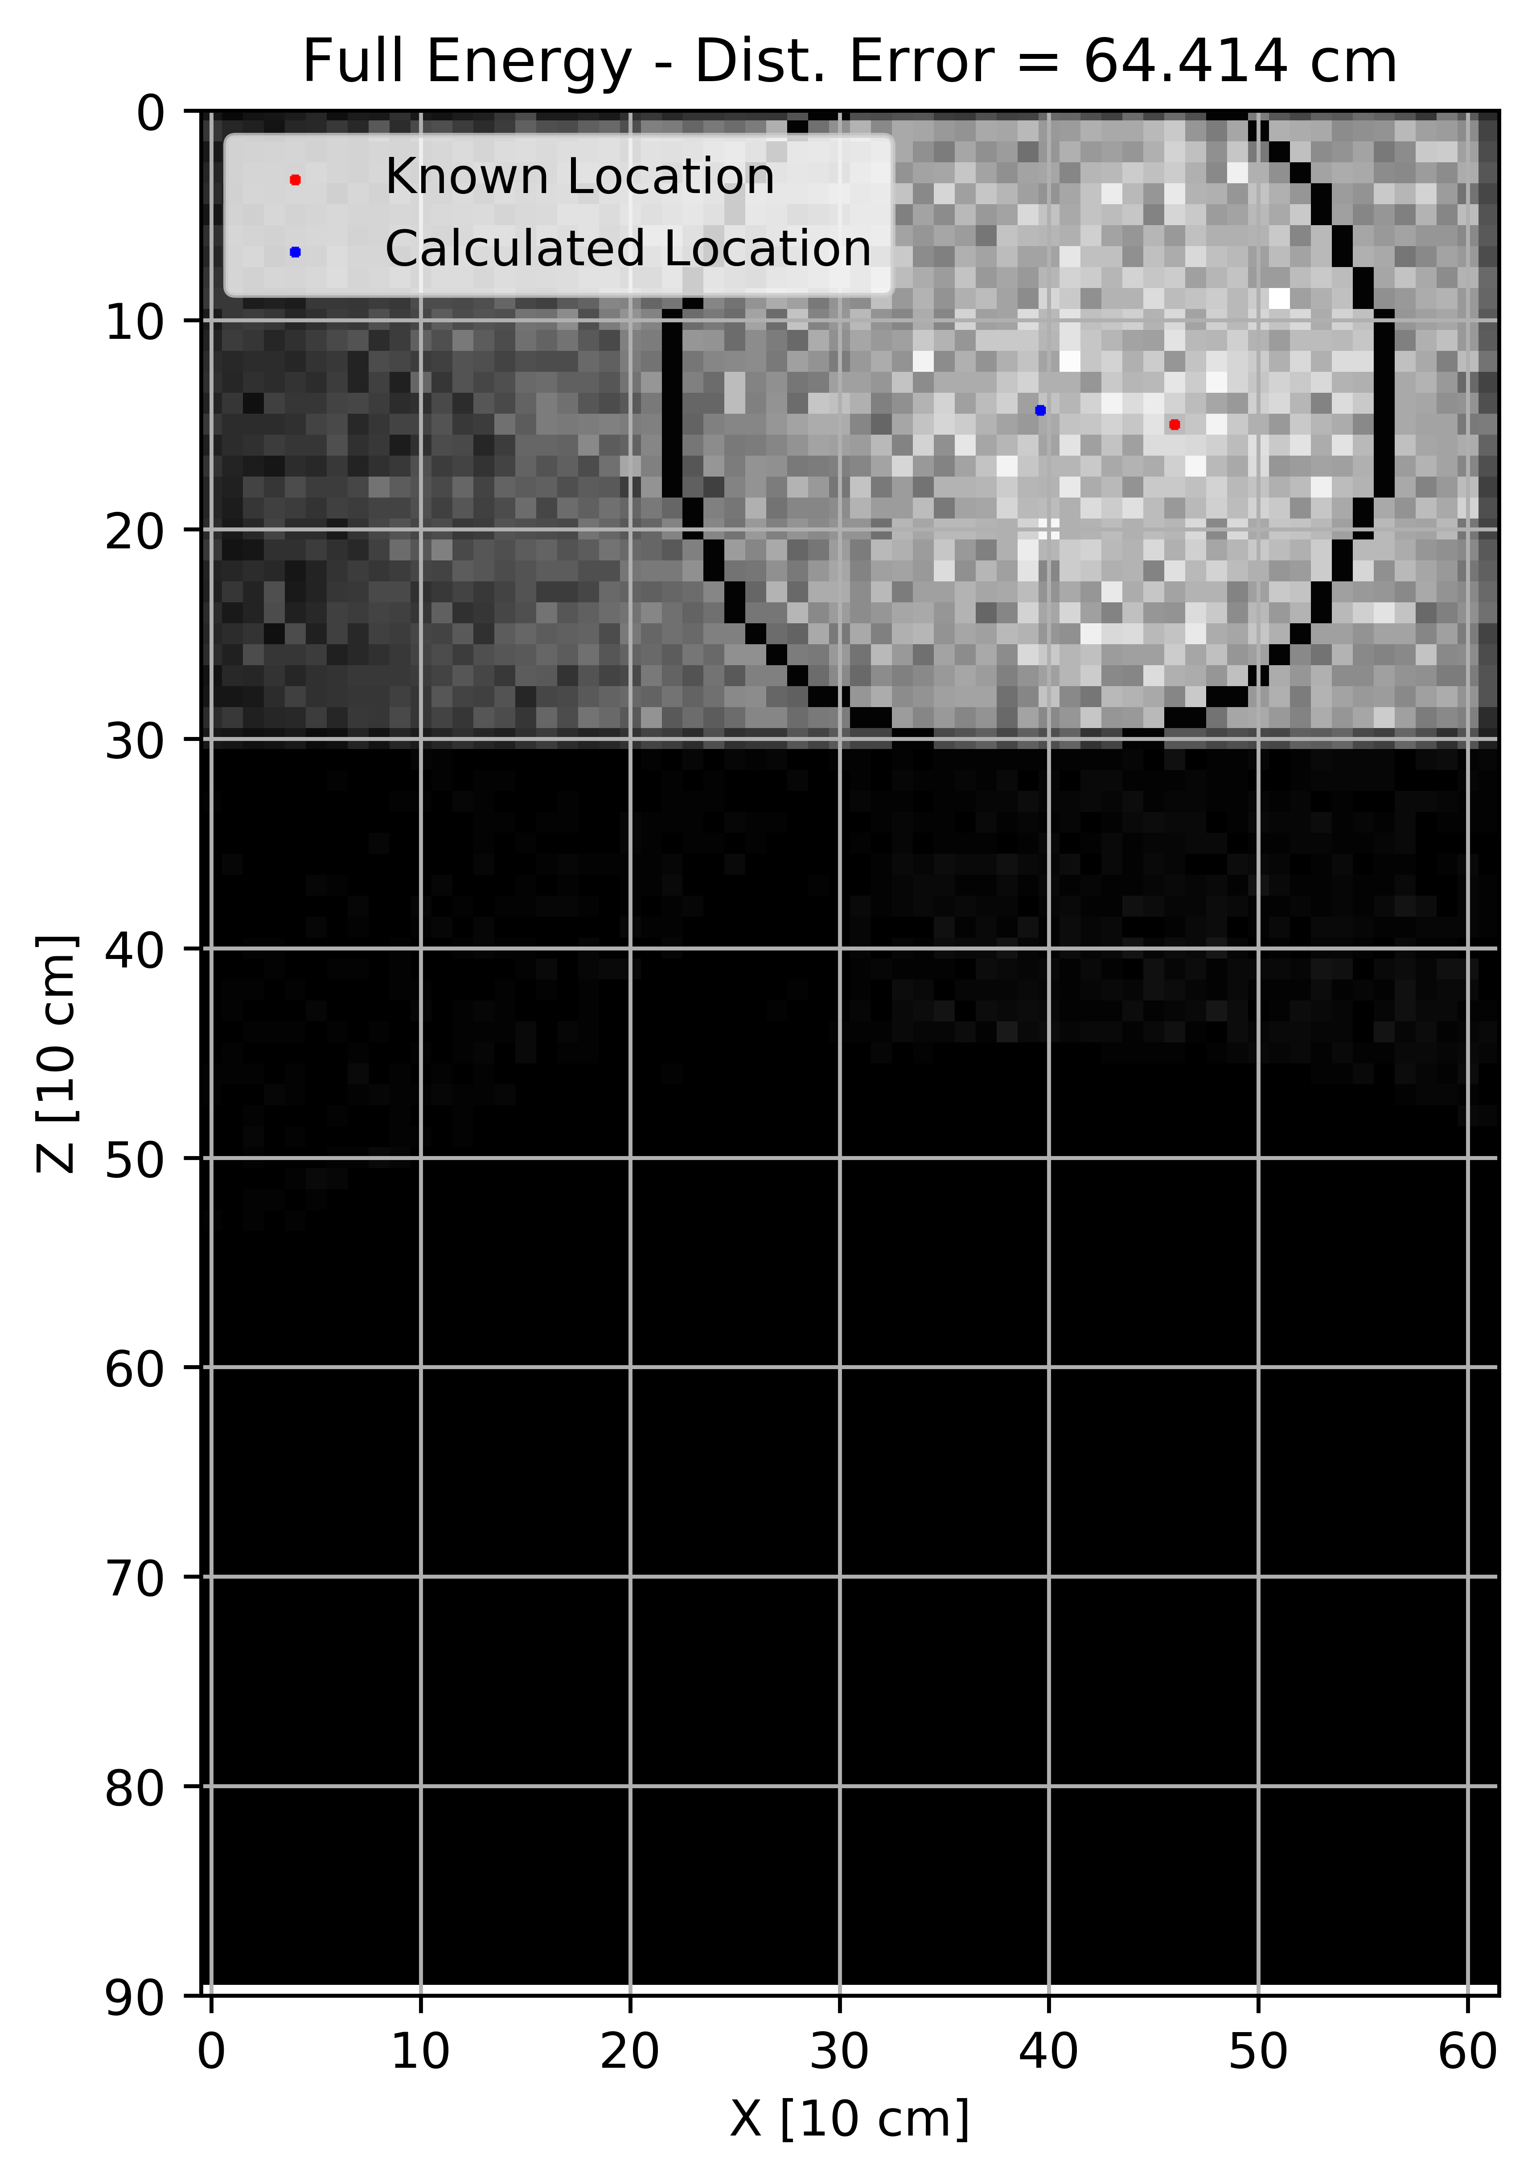
LOCALIZATION: Canny Edge Finder and RANSAC fit – Full Energy
⁶⁰Co Source Located on 3rd Floor of BLDG
Viewing from North
Notes:
Explain features

Slide 40
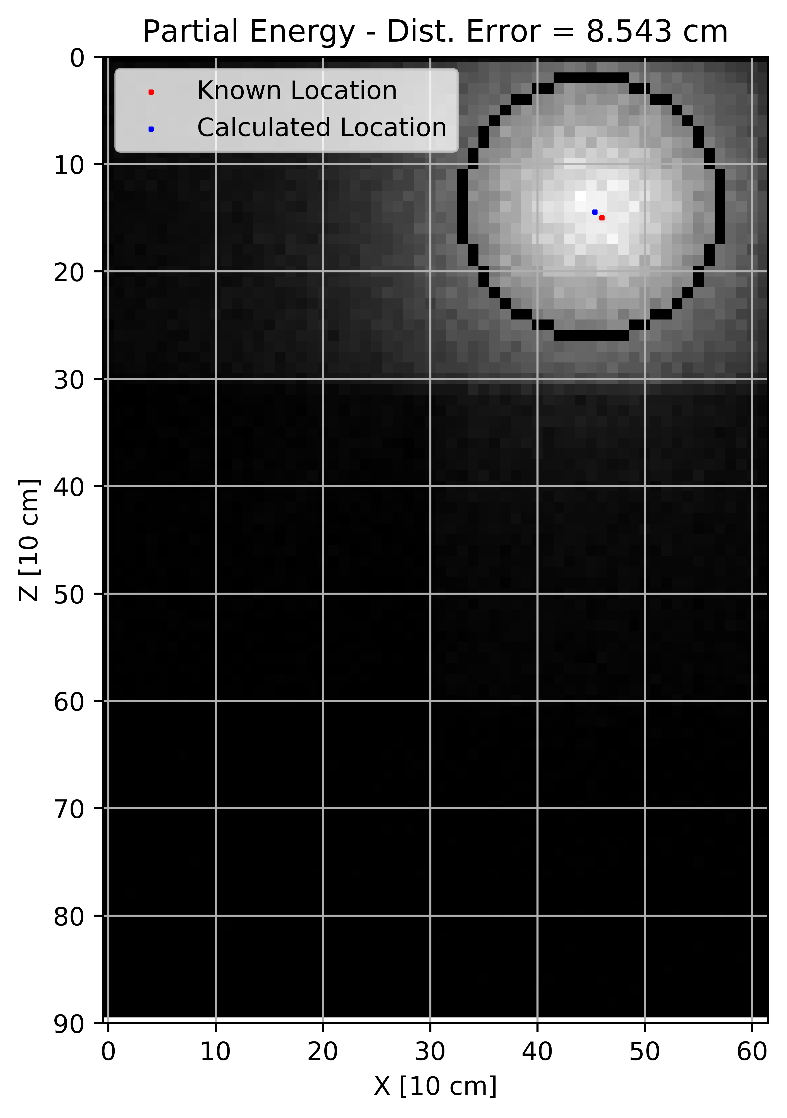
LOCALIZATION: Canny Edge Finder and RANSAC fit – Partial Energy
⁶⁰Co Source Located on 3rd Floor of BLDG
Viewing from South
Notes:
Explain features

Slide 41
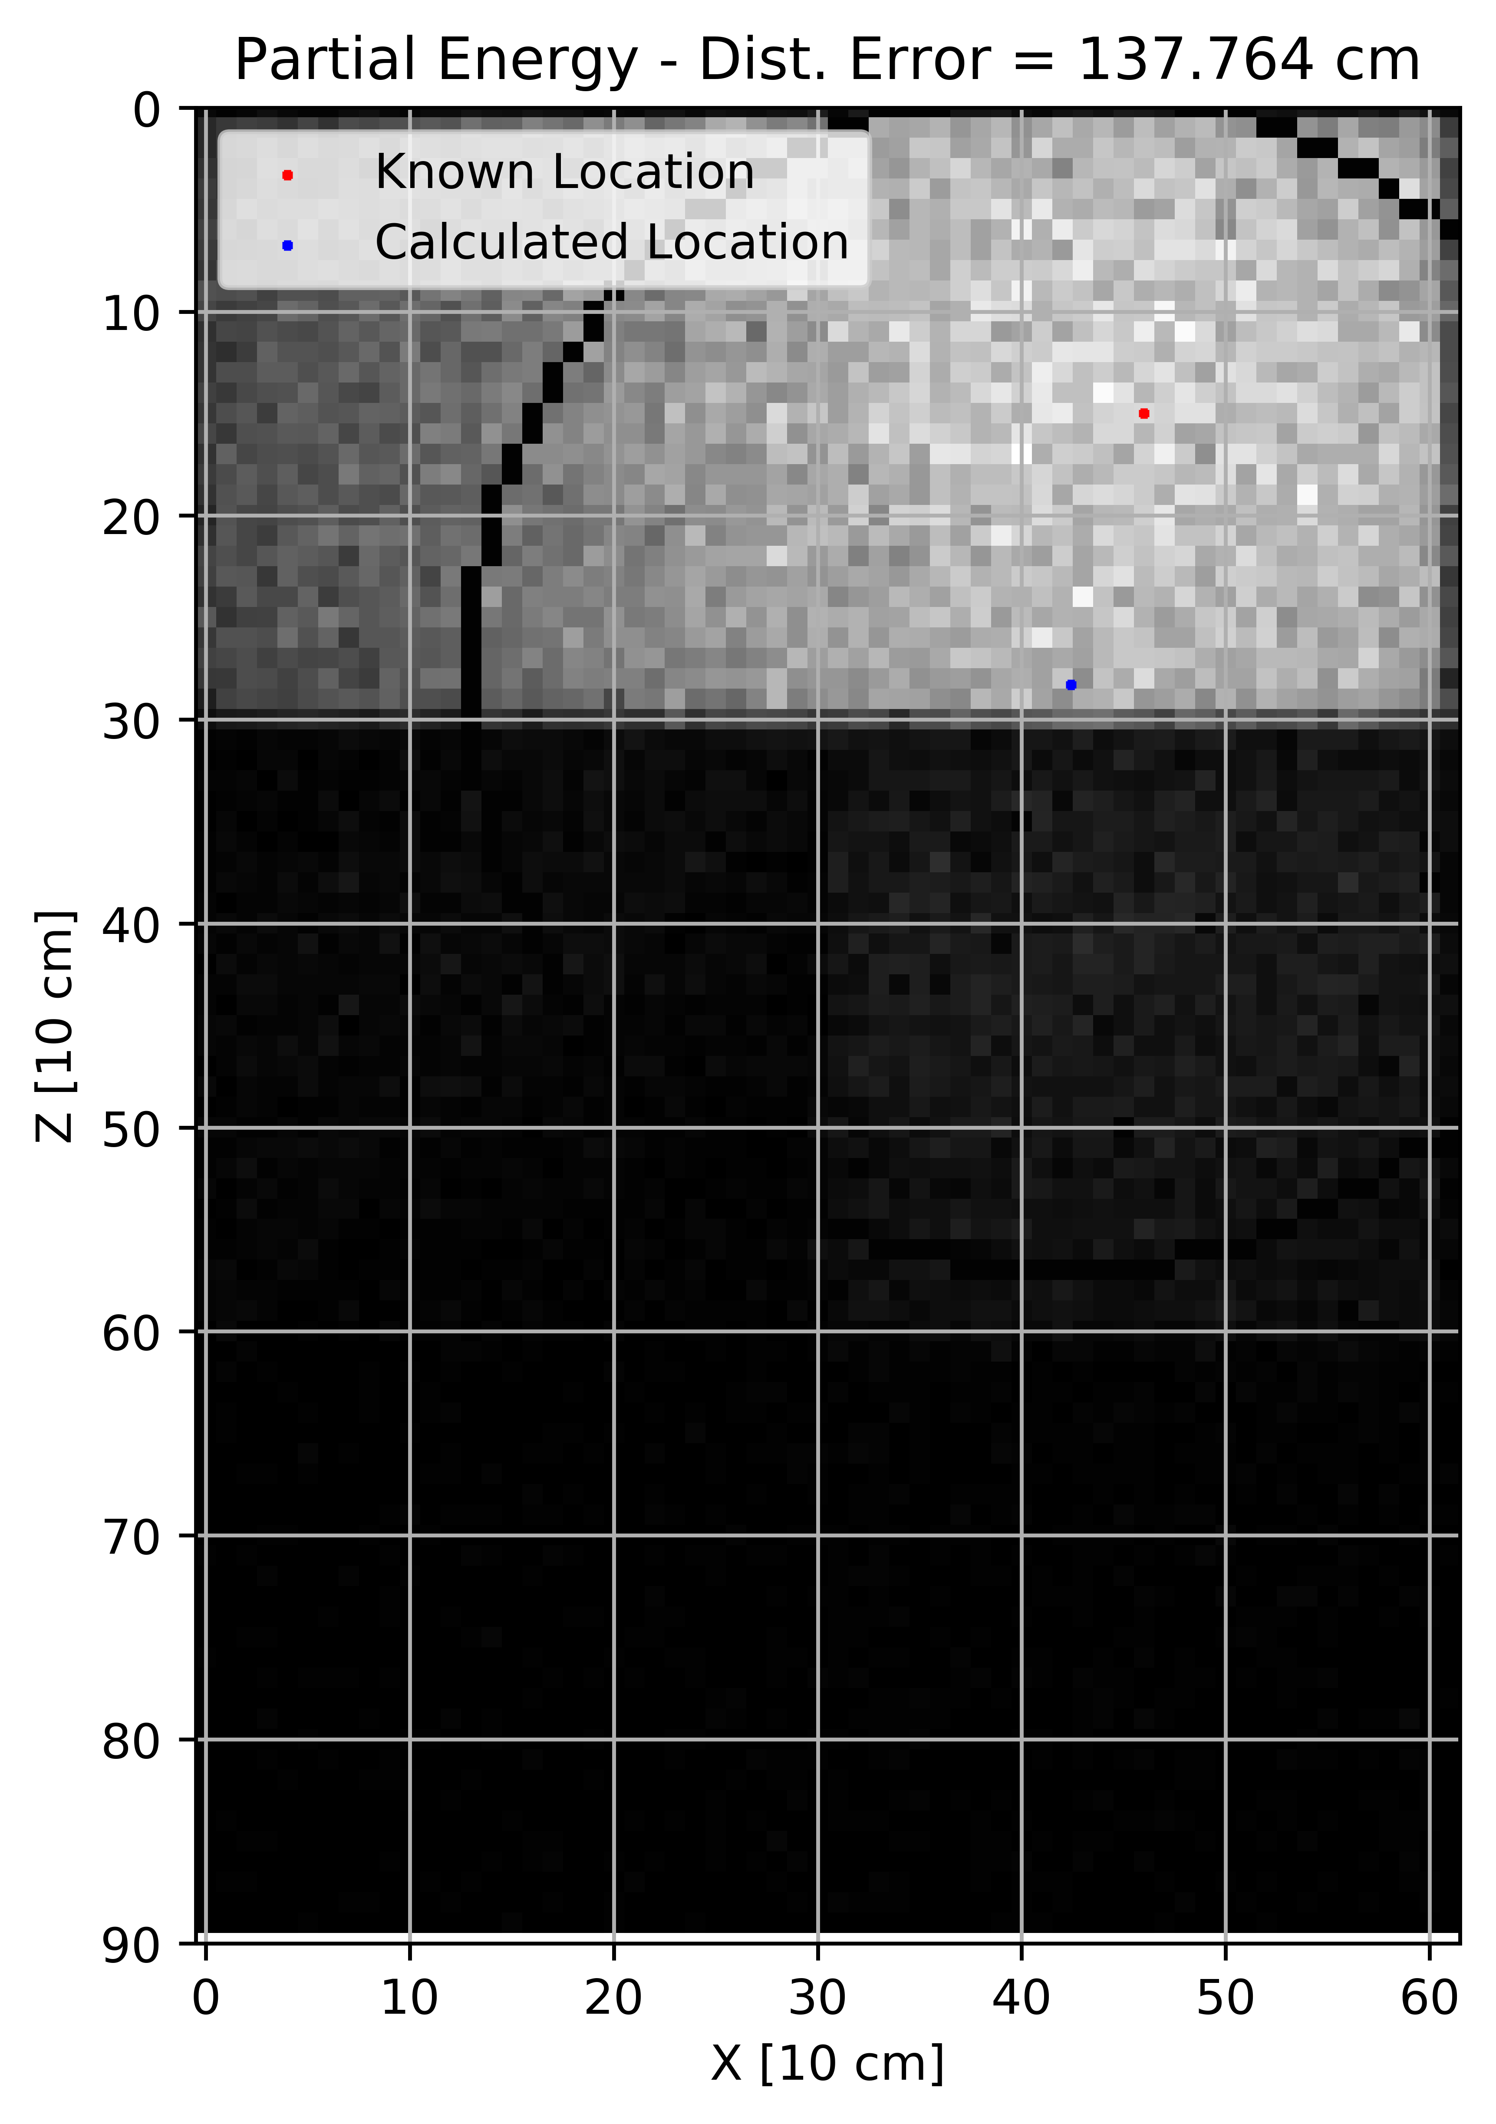
LOCALIZATION: Canny Edge Finder and RANSAC fit – Partial Energy
⁶⁰Co Source Located on 3rd Floor of BLDG
Viewing from North
Notes:
Explain features

Slide 42
LOCALIZATION: Linear Error
Floor | Location | Response | Error [cm]
1 | Central | Total | 165.76
1 | Central | Full E | 92.95
1 | Central | Partial E | 173.09
1 | Middle | Total | 138.86
1 | Middle | Full E | 54.52
1 | Middle | Partial E | 100.95
1 | Wall | Total | 394.93
1 | Wall | Full E | 30.22
1 | Wall | Partial E | 354.67
2 | Central | Total | 134.64
2 | Central | Full E | 101.34
2 | Central | Partial E | 149.89
2 | Middle | Total | 36.30
2 | Middle | Full E | 79.29
2 | Middle | Partial E | 48.54
2 | Wall | Total | 316.12
2 | Wall | Full E | 7.43
2 | Wall | Partial E | 51.54
3 | Central | Total | 89.33
3 | Central | Full E | 37.25
3 | Central | Partial E | 99.52
3 | Middle | Total | 36.14
3 | Middle | Full E | 23.86
3 | Middle | Partial E | 36.91
3 | Wall | Total | 361.73
3 | Wall | Full E | 36.40
3 | Wall | Partial E | 385.27
Response | Mean Error [cm] | Standard Deviation [cm]
Total | 185.98 | 129.51
Full Energy | 51.47 | 30.86
Partial Energy | 155.60 | 122.58
Notes:
Explain features

Slide 43
CONCLUSIONS:
Produced Incident Flux at detector location and back projected to visualize quantified energy transmission through material surface
Demonstrated accurate source localization external to building
Demonstrated segregating by full energy transmission increases accuracy to
FUTURE WORK:
Introduce “real” detector characteristics and positional uncertainty
Use lower activity/energy source (¹³⁷Cs) and introduce background radiation
Use geometry and materials of a known structure and compare results with current systems
Implement rejection criteria in localization
Notes:
Future work should focus on feasibility in a real world environment. Scan speed for LAMP is 3 m/s. That would take ~ 49 minutes to scan in this manner.
1 KBq = 100 min
1 MBq = 6 sec
1 TBq = Instantaneous
Source Activity is high enough to achieve these results but a lower activity/energy source would produce gammas at a much lower rate and less would be strong enough to penetrate the material. Time of collection if drastically increased could probability of adversary detonation.

Slide 44
Questions?

